Slide 1
CGNs in IP
What are you going to do about it?
Mark Kosters, ARIN
Geoff Huston, APNIC

Slide 2
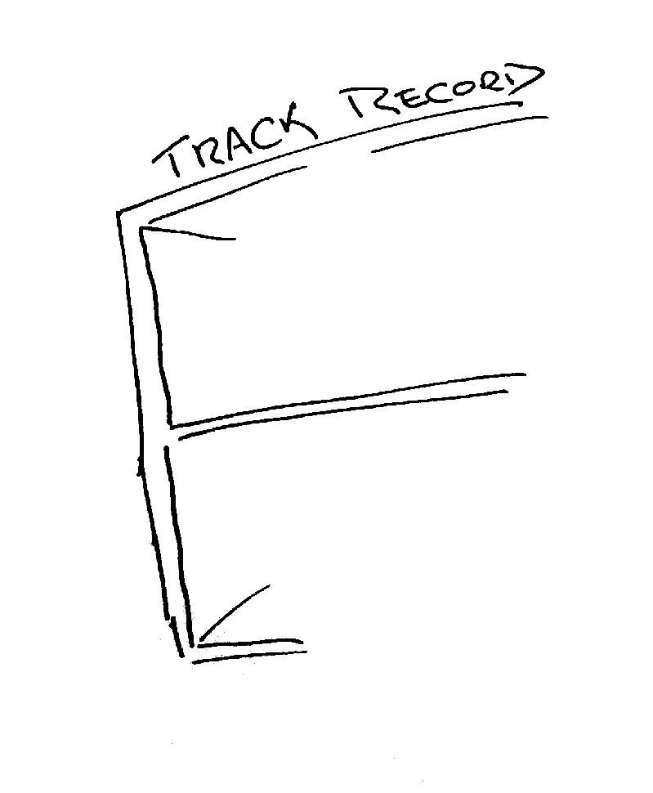
The mainstream telecommunications industry has a rich history

Slide 3


The mainstream telecommunications industry has a rich history
…of making very poor
technology choices

Slide 4


The mainstream telecommunications industry has a rich history
…of making very poor
technology guesses
and regularly being
taken by
surprise!

Slide 5
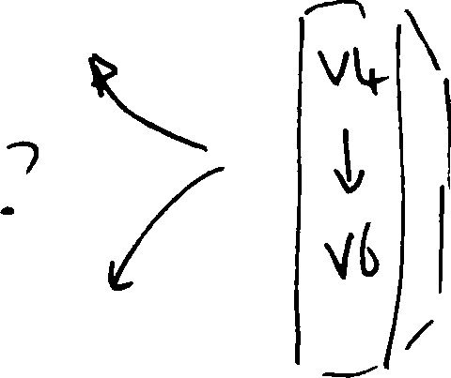
So, how are we going with the IPv4 to IPv6 transition?

Slide 6
The Amazing Success of the Internet
2.3 billion users!
4 online hours per day per user!
4% of the world GDP

Slide 7
The Amazing Success of the Internet
2.3 billion users!
4 online hours per day per user!
4% of the world GDP
Just about anything about the Internet
Time

Slide 8
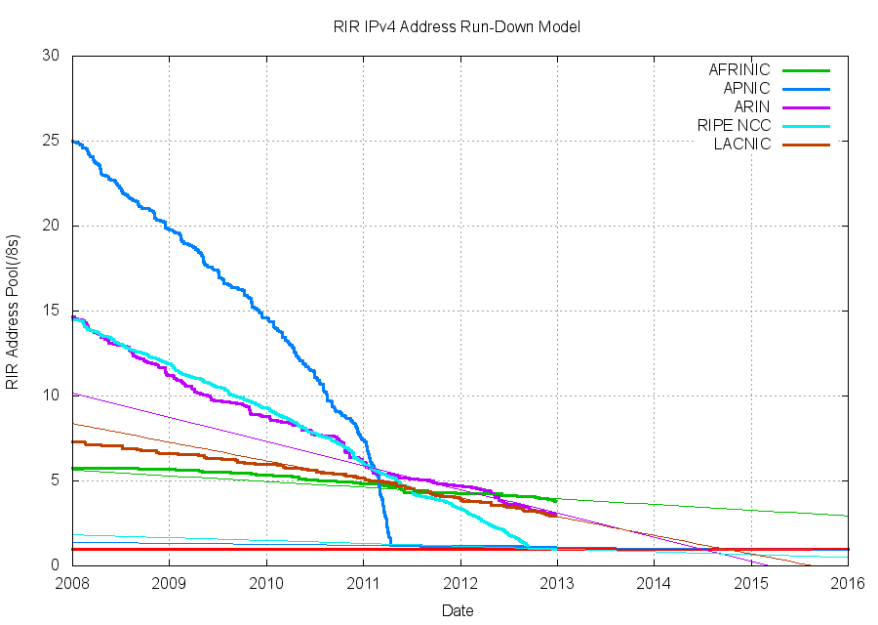
Success-Disaster

Slide 9
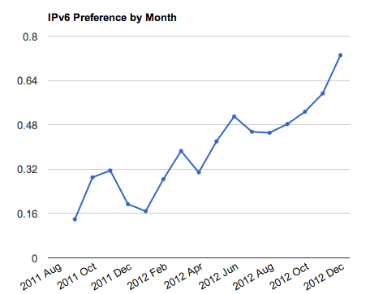
Success-Disaster
Fractions
of a percent!

Slide 10
The Original IPv6 Plan c. 1995
Size of the Internet
IPv6 Deployment
IPv6 Transition – Dual Stack
IPv4 Pool Size
Time

Slide 11
The Revised IPv6 Plan c. 2005
IPv4 Pool Size
Size of the Internet
IPv6 Transition – Dual Stack
IPv6 Deployment
2004
2006
2008
2010
2012
Date

Slide 12

Oops!
We were meant to have completed the transition to IPv6 BEFORE we completely exhausted the supply channels of IPv4 addresses!

Slide 13
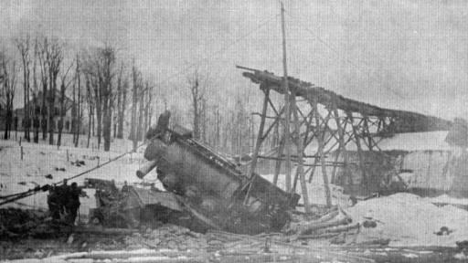
Today’s Plan
IPv4 Pool
Size
Today
Size of the
Internet
?
IPv6 Transition
IPv6 Deployment
0.8%
Time

Slide 14
Transition ...
The downside of an end-to-end architecture:

Slide 15
Transition ...
The downside of an end-to-end architecture:
  There is no backwards compatibility across protocol families
  A V6-only host cannot communicate with a V4-only host

Slide 16
Transition ...
We have been forced to undertake a “Dual Stack” transition:

Slide 17
Transition ...
We have been forced to undertake a “Dual Stack” transition:
  Provision the entire network with both IPv4 AND IPv6

Slide 18
Transition ...
We have been forced to undertake a “Dual Stack” transition:
  Provision the entire network with both IPv4 AND IPv6
  In Dual Stack hosts configure the hosts’ applications to prefer IPv6 to Ipv4

Slide 19
Transition ...
We have been forced to undertake a “Dual Stack” transition:
  Provision the entire network with both IPv4 AND IPv6
  In Dual Stack hosts configure the hosts’ applications to prefer IPv6 to Ipv4
  When the traffic volumes of IPv4 dwindle to insignificant levels, then its possible to shut down support for IPv4

Slide 20
Dual Stack Transition ...

Slide 21
Dual Stack Transition ...
We did not appreciate the operational problems with this dual stack plan while it was just a paper exercise

Slide 22
Dual Stack Transition ...
We did not appreciate the operational problems with this dual stack plan while it was just a paper exercise
The combination of an end host preference for IPv6 and a disconnected set of IPv6 “islands” created operational problems
  Protocol “failover” from IPv6 to IPv4 takes between 19 and 108 seconds (depending on the operating system configuration)
  This is unacceptably slow
Attempting to “bridge” the islands with IPv6-in-IPv4 tunnels created a new collection of IPv6 path MTU Discovery operational problems
  There are too many deployed network paths contain firewall filters that block all forms of IMCP, including ICMP6 Packet Too Big
Attempts to use end-host IPv6 tunneling also presents operational problems
  Widespread use of protocol 41 (IP-in-IP) firewall filters
  Path MTU problems

Slide 23
Dual Stack Transition
Signal to the ISPs:
  Deploy IPv6 and expose your users to operational problems in IPv6 connectivity
  Or
  Delay IPv6 deployment and wait for these operational issues to be solved by someone else
So we wait...

Slide 24
And while we wait...
The Internet continues its growth
And without an abundant supply of IPv4 addresses to support this level of growth then the industry is increasingly reliant on NATs:
  Edge NATs are now the defacto choice for residential broadband services at the CPE
  ISP NATs are now the defacto choice for 3G and 4G mobile IP services

Slide 25
NATTing the Net
In 2012:
  The RIRs made 8,547 allocations to LIRs, allocating a total of 114M IPv4 addresses
  The routing table grew by 120M addresses
  The ISC host survey* indicates a growth of ~60M visible hosts
  BUT
    In 2012 Apple sold ~110M iPhones and ~60M iPads and they have ~30% market share globally
    This implies that some ~560M mobile devices were sold in the last 12 months
  It appears that the NATTed Internet grew by ~550M devices in the last 12 months!
* http://www.isc.org/solutions/survey

Slide 26
The Anatomy of NATs
NAT
“Interior”
“Exterior”
Private Address Space
Public Address Space
Source address (private)
Destination address
Source port (private)
Destination port
Translation Table
Source address (public)
Destination address
Source port (public)
Destination port
Source address (private)
Destination address
Source port (private)
Destination port
Source address (public)
Destination address
Source port (public)
Destination port

Slide 27
The Anatomy of NATs
Translation Table:
Interior Exterior
Binding Time Protocol Address/Port /Address/Port
TCP or UDP
Interior IP address
and Port number
Exterior IP address
and Port number
Timer

Slide 28
Design Parameters
TCP
Open NAT Binding:
  Interior SYN
Access NAT Binding
  Symmetric (same exterior IP address, same exterior port)
Release NAT Binding:
  Interior RST
  Interior FIN?
  Exterior FIN?
  Exterior RST?
  Timer?
UDP
Open NAT Binding
  Interior packet
Access NAT Binding
  Symmetric (same exterior IP address, same exterior port)
  Full cone (any exterior IP address, any exterior port)?
  Restricted cone (same exterior IP address, any exterior port)?
  Port-restricted code (any exterior IP address, same exterior port)?
Release NAT Binding:
  Timer?
Port Control Protocols
STUN/TURN
PCP relay of UPnP and NAT-PMP

Slide 29
Design Parameters
TCP
Open NAT Binding:
  Interior SYN
Access NAT Binding
  Symmetric (same exterior IP address, same exterior port)
Release NAT Binding:
  Interior RST
  Interior FIN?
  Exterior FIN?
  Exterior RST?
  Timer?
UDP
Open NAT Binding
  Interior packet
Access NAT Binding
  Symmetric (same exterior IP address, same exterior port)
  Full cone (any exterior IP address, any exterior port)?
  Restricted cone (same exterior IP address, any exterior port)?
  Port-restricted code (any exterior IP address, same exterior port)?
Release NAT Binding:
  Timer?
Different NATs make different choices in these design parameters
Applications then have to “discover” the particular behavioral type in order to perform non-trivial operations
This adds delay, complexity and fragility to the service model of the network
Port Control Protocols
STUN/TURN
PCP relay of UPnP and NAT-PMP

Slide 30
2 Party NATs
AKA Subscriber-Based NATs
Relieved pressure for IPv4 space
Is nearly everywhere
Home Network
Middle Box
Internet
IPv4
192.168.0.0/24
IPv4
Globally Unique Address

Slide 31
3 Party NATs
AKA Carrier Grade NAT
Adds a new non-unique realm in the Carrier
Adds more complexity but “slows” runout
Carrier
CGN
Home Network
Edge NAT
IPv4 Private Space
10.0.0/8
Internet
IPv4 Private Space
192.168.0.0/24
IPv4
Globally Unique Address

Slide 32
Some Multi-NAT Issues
Home Network
Edge NAT
Carrier
CGN
Internet
What is the aggregate NAT binding behavior as seen by an application?
How can an application “discover” this aggregate binding behaviour?
Can an application determine how many NATs (and of what type) are in its data path?
Does the carrier need a new private address space that is distinct from RFC1918 address space?
How does home-to-home work in this model?
Does this model become more complex with 3 NATs in series?

Slide 33
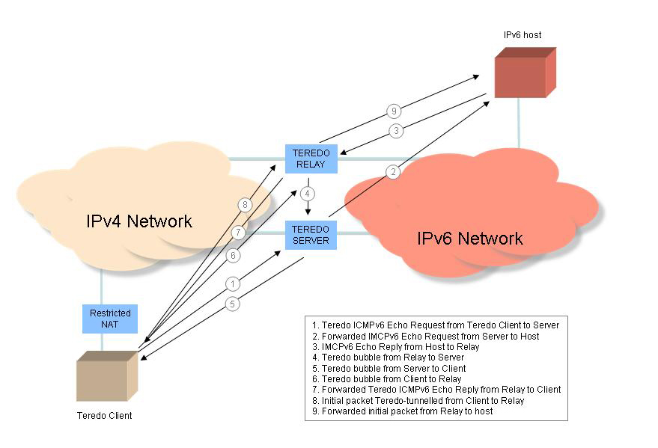
How Good Are NATs?
3-party rendezvous:
A knows about B and C
A tells B to contact C
Teredo is a good example here:

Slide 34
NAT Failure
How well do NATs perform in supporting an application performing a 3-party rendezvous?
  One way to measure this is to test a common 3-party rendezvous application across a large number of clients
  So we measured it
  And we were pretty surprised

Slide 35
Teredo Failure Rate
ICMP Exchange fails to complete
ICMP completed, but SYN Exchange fails to complete

Slide 36
It’s NAT Traversal Failure
Teredo failure is around 35% of all connection attempts
  Obviously, this is unacceptably high!
  This is unlikely to be local filtering effects given that Teredo presents to the local NAT as conventional IPv4 UDP packets
  More likely is the failure of the Teredo protocol to correctly identify the behaviour mode of the local NAT device
  The ICMP failure rate comes from the limited number of UDP NAT traversal models used by the Teredo handshake protocol vs the variance of UDP NAT traversal models used in networks
  The SYN failure rate is a result of the Teredo protocol making incorrect assumptions about the NAT’s behaviour

Slide 37
Working with Failure
A 35% connection failure is unworkable is almost all circumstances
But one particular application can thrive in this environment – Bit Torrent:
  The massive redundancy of the data set across multiple sources reduces the sensitivity of individual session failures
All other protocols fail under such adverse conditions

Slide 38
CGN Deployment
What’s the likely outcome of widespread CGN deployment on today’s Internet?
  It’s TCP, UDP or failure!
  It’s simple client-server 2-party rendezvous or failure!
  It’s network path symmetry, or failure!
Really simple transactions in a restricted application environment will still function, but not much else can be assumed to work

Slide 39
What’s the New New Plan?
If NATs make the network complex and fragile,
And the IPv6 deployment program continued to proceed at a geological pace,
Then what are we going to do to make the Internet work for the next 5 years of growth?
  And don’t say “SDN”
  Or “OpenFlow”

Slide 40
What’s the New New Plan?
How can we pull the Internet though a middleware dense environment for the next 5 years?
  What application models are robust in a CGN-dense world
  How do CGNs break?
  How variable are CGNs?
  What will applications need to cope with?

Slide 41
What would help
Can we perform wide scale measurements of NAT robustness?
Is there improvements that can be learned from testing?
How?

Slide 42
And what would not
Inaction

