Slide 1
Measuring the KSK Roll
Geoff Huston
APNIC Labs

Slide 2
KSK Roll Measurement Objective
What number of users are at risk of being impacted by the KSK Roll?

Slide 3
KSK Roll Measurement Objective
were
What number of users are at risk of being impacted by the KSK Roll?

Slide 4
What we would like the DNS to be
Client
DNS Resolver
DNS Server

Slide 5
What we suspect is in the DNS
Client
DNS Resolver
DNS Server
DNS Server
DNS Resolver
DNS Resolver
DNS Resolver
DNS Server
DNS Resolver
DNS Resolver
DNS Resolver
DNS Resolver
DNS Resolver
DNS Resolver
DNS Resolver
DNS Resolver
DNS Resolver

Slide 6
Signalling via Queries
Client
DNS Resolver
Server
Queries
DNS Resolver
DNS Resolver
DNS Resolver
DNS Resolver
The query contains added resolver information which passes inward in the DNS towards the authoritative server(s)
DNS Resolver
DNS Resolver
DNS Resolver
DNS Resolver
DNS Resolver
DNS Resolver
DNS Resolver
DNS Resolver

Slide 7
Signalling via Responses
Client
DNS Resolver
Server
Responses
DNS Resolver
DNS Resolver
DNS Resolver
DNS Resolver
The response contains added information or altered behavious which passes backward in the DNS towards the original querier
DNS Resolver
DNS Resolver
DNS Resolver
DNS Resolver
DNS Resolver
DNS Resolver
DNS Resolver
DNS Resolver

Slide 8
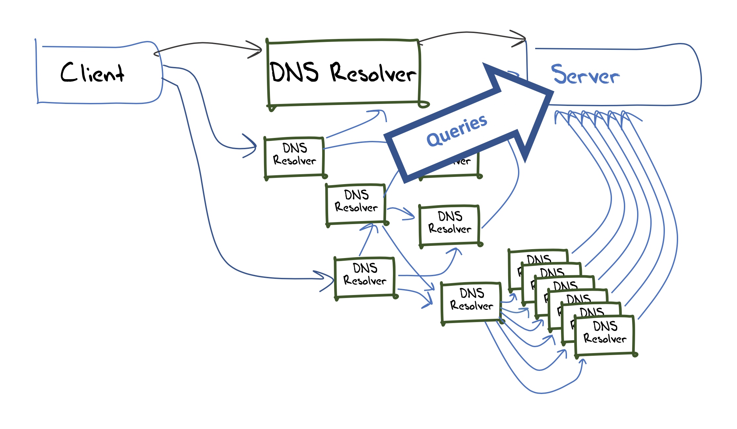
Measuring Resolvers with RFC 8145
Getting resolvers to report on their local trusted key state
  A change to resolver behavior that requires deployment of new resolver code
  Resolvers that support the RFC 8145 signal mechanism periodically include the key tag of their locally trusted keys into a query directed towards the root servers

Slide 9
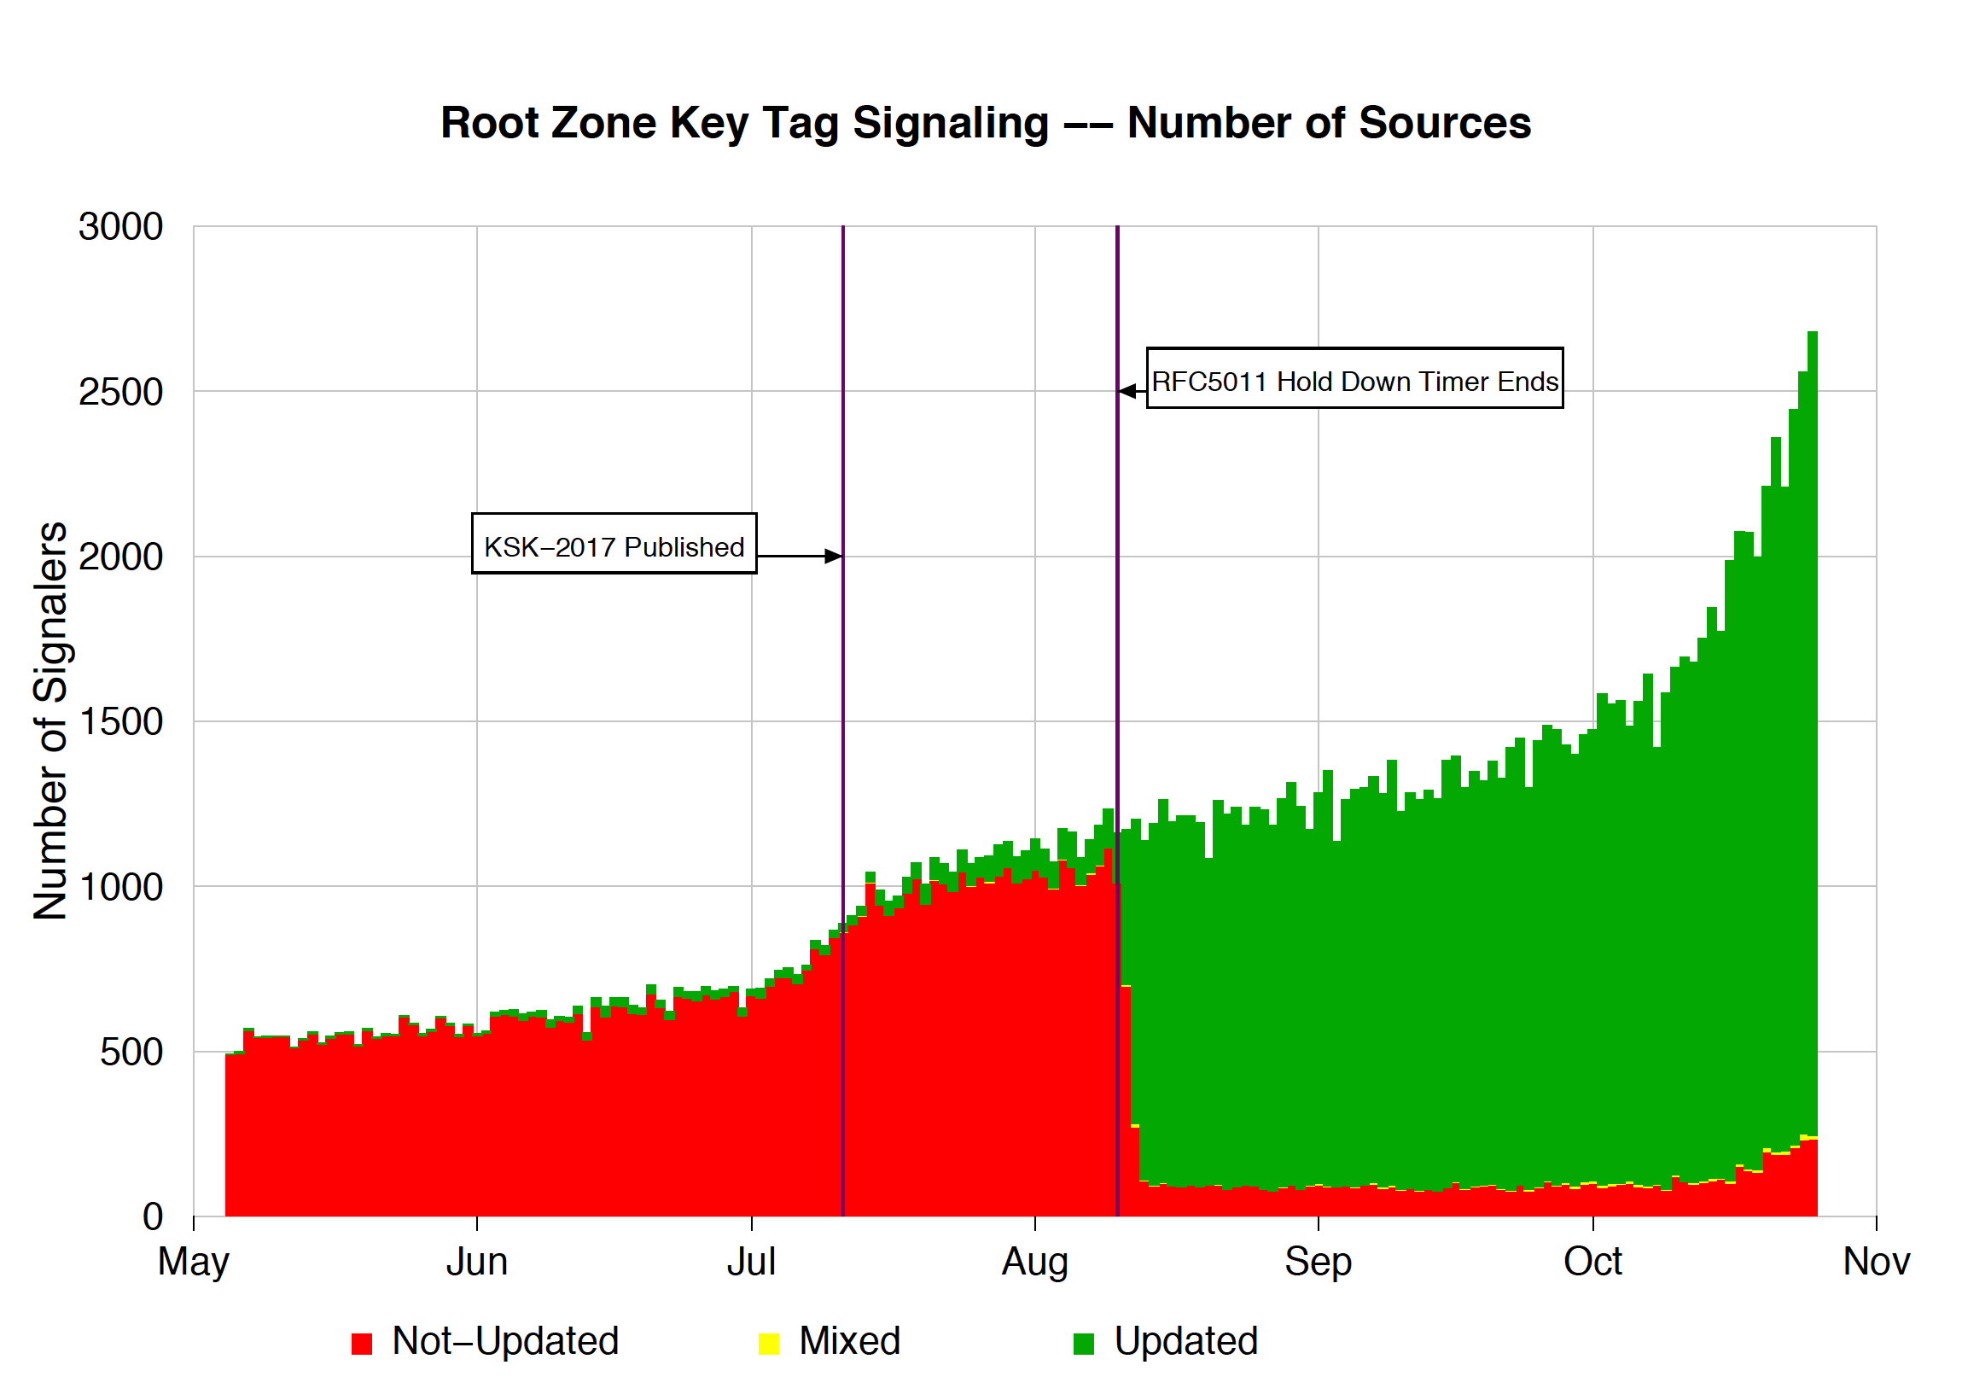
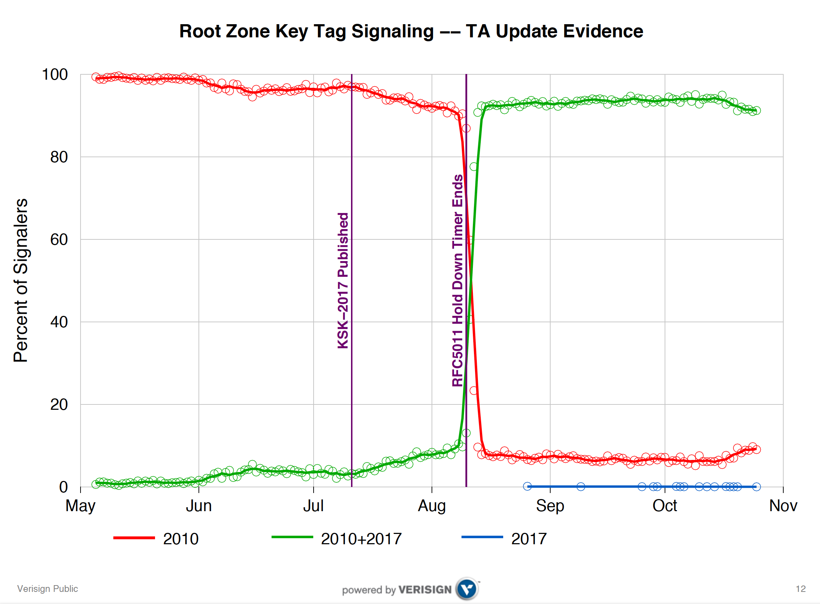
What did we see at the roots?
Duane Wessels VeriSign RFC 8145 Signaling Trust Anchor Knowledge In DNS Security Extensions
Presentation to DNSSEC Workshop @ ICANN 60 – 1 Nov 2017
https://schd.ws/hosted_files/icann60abudhabi2017/ea/Duane%20Wessels-VeriSign-RFC%208145-Signaling%20Trust%20Anchor%20Knowledge%20in%20DNS%20Security%20Extensions.pdf

Slide 10
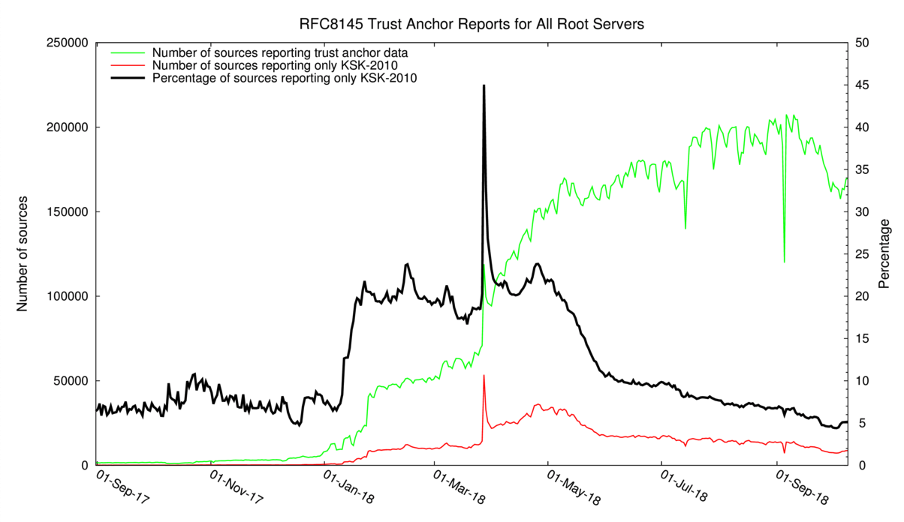
12 months of RFC8145 signalling
Yes, with just a few days to go this mechanism was still reporting 5% ‘breakage’
http://root-trust-anchor-reports.research.icann.org

Slide 11
What is this saying?
It’s clear that there is some residual set of resolvers that are signalling that they have not yet learned to trust the new KSK key
But its not clear if:
  This is an accurate signal about the state of this resolver
  This is an accurate signal about the identity of this resolver
  How many users sit ‘behind’ this resolver
  Whether these uses rely solely on this resolver, or if they also have alternate resolvers that they can use
  What proportion of all users are affected

Slide 12
Why?
Because the DNS does not disclose the antecedents of a query
  If A forwards a query to B, who queries a Root Server then if the query contains an implicit signal (as in this case) then it appears that B is querying, not A
  At no time is the user made visible in the referred query
Because caching
  If A and B both forward their queries via C, then it may be that one or both of these queries may be answered from C’s cache
  In this case the signal is being suppressed
Because its actually measuring a cause, not the outcome
  Its measuring resolvers’ uptake of the new KSK, but is not able to measure the user impact of this

Slide 13
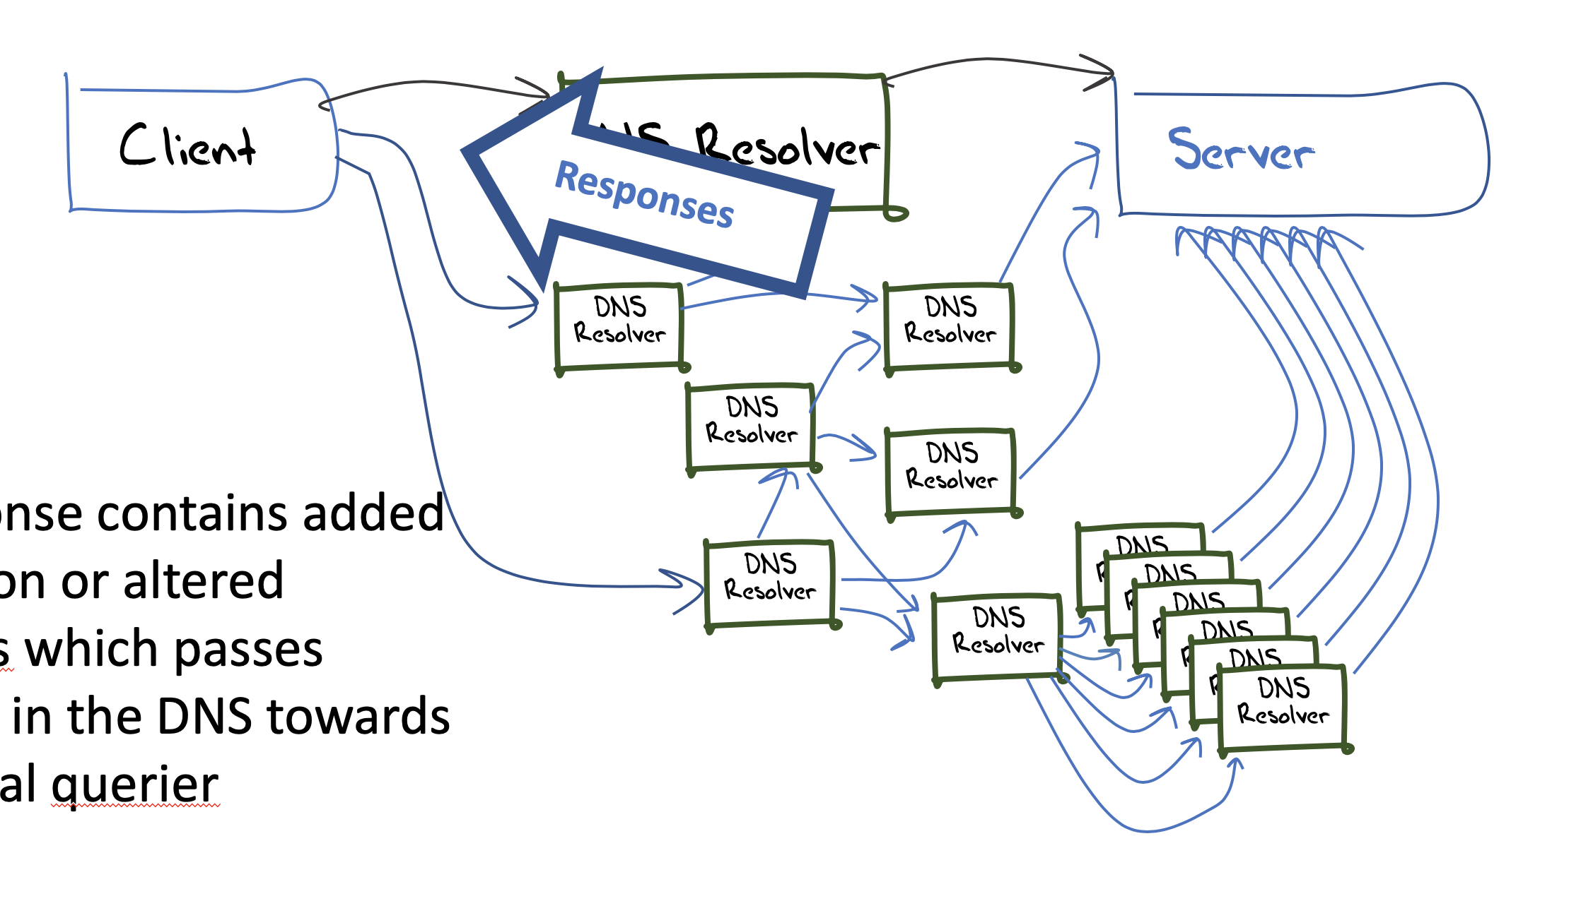
User-Side Measurement
Can we devise a DNS query that could reveal the state of the trusted keys of the resolvers back to the user?
  What about a change to the resolver’s reporting of validation outcome depending on the resolver’s local trusted key state?
    If a query contains the label “root-key-sentinel-is-ta-<key-tag>” then a validating resolver will report validation failure if the key is NOT in the local trusted key store
    If a query contains the label “root-key-sentinel-not-ta-<key-tag>” then a validating resolver will report validation failure if the key IS in the local trusted key store

Slide 14
DNS + Web
How can you tell if a user is able to resolve a DNS name?
  Be the user (get the user to run a script of some sort)
  Look at the DNS server AND the Web server
    The Web object is fetched only when the DNS provides a resolution answer
    But the opposite is not necessarily the case, so there is a noise component in such an approach

Slide 15
Prior to the KSK Roll
16% of users use DNSSEC-validating resolvers
15% of users do not report
their KSK trust-state
0.5% of users report KSK-2017
loaded
0.005% of users report KSK-2017
NOT loaded

Slide 16
Possibly Affected Users
Between 0.1% to 0.2% of users are reporting that their resolvers have not loaded KSK-2017 as a trust anchor
The measurement has many uncertainties and many sources of noise so this is an upper bound of the pool of users who may encounter DNS failure due to to the KSK roll

Slide 17
But
Not all resolvers will pre-provision KSK-2017 using RFC 5011 automated trust mechanisms – they may elect to load the new trsut anchor at the time of the roll manually
  And we cannot measure the difference between a resolver that has a broken implementation of RFC5011 and a resolver that is being managed manually
Only recently upgraded resolvers have this test behaviour included
  But the resolvers we worry about are the crufty ones at the bottom of the rack that have been all but forgotten!

Slide 18
What happened
Sidn Labs Atlas Measurement

Slide 19
What we saw
% of folk that reported “good”
KSK roll period
% of folk that reported “bad”

Slide 20
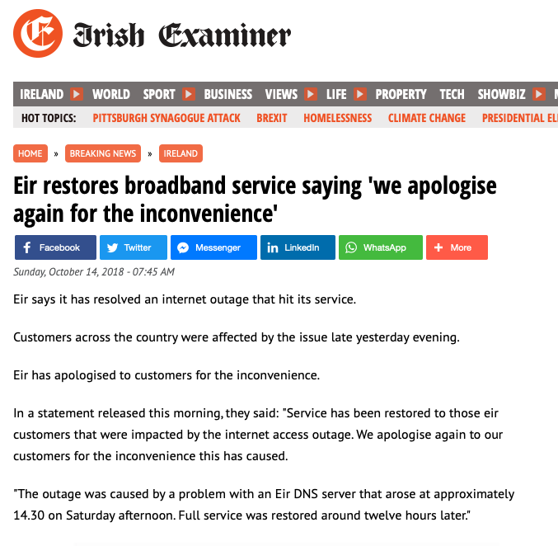

What we heard

Slide 21
What happens when you lose track of the KSK?

Slide 22
Everything goes black

Slide 23
EIR - AS5466 DNSSEC Data
Daily Sample Count
Validating Sample Count
KSK Roll Cache Expiry

Slide 24
Internet DNSSEC Data
Is this part-related to the KSK Roll?

Slide 25
Looking for Affected Networks
Lets use the following filter:
  More than 400 samples / day in the lead up to the KSK roll (using weighted sample count)
  DNSSEC validation level more than 30% prior to the KSK roll
  Drop of more than 33% in DNSSEC validation during the KSK roll

Slide 26
Rank AS CC Seen Validating As Name
Before During After Before During After
1 AS2018 ZA 1,858 1,122 1,473 694 220 288 TENET, South Africa
2 AS10396 PR 1,789 1,673 1,988 1,647 276 33 COQUI-NET - DATACOM CARIBE, Puerto Rico
3 AS45773 PK 1,553 388 1,393 606 178 540 HECPERN-AS-PK PERN, Pakistan
4 AS15169 IN 1,271 438 1,286 1,209 438 1,242 GOOGLE - Google LLC, India
5 AS22616 US 1,264 503 1,526 883 377 1,014 ZSCALER- SJC, US
6 AS53813 IN 1,213 689 1,862 1,063 582 1,419 ZSCALER, India
7 AS1916 BR 1,062 94 991 326 37 277 Rede Nacional de Ensino e Pesquisa, Brazil
8 AS9658 PH 931 281 842 440 136 404 ETPI-IDS-AS-AP Eastern Telecoms, Philippines
9 AS37406 SS 888 486 972 582 365 599 RCS, South Sudan
10 AS263327 BR 882 345 438 776 289 359 ONLINE SERVICOS DE TELECOMUNICACOES, Brazil
11 AS17557 PK 835 430 777 431 277 413 Pakistan Telecommunication, Pakistan
12 AS36914 KE 834 476 937 583 354 670 KENET , Kenya
13 AS327687 UG 802 473 834 390 189 332 RENU, Uganda
14 AS680 DE 773 966 1,332 268 117 289 DFN Verein zur Foerderung, Germany
15 AS201767 UZ 761 538 729 461 200 371 UZMOBILE, Uzbekistan
16 AS37682 NG 695 401 728 593 274 568 TIZETI, Nigeria
17 AS7470 TH 674 214 507 219 94 182 True Internet, Thailand
18 AS51167 DE 670 378 479 214 78 156 CONTABO, Germany
19 AS15525 PT 600 260 593 287 125 284 MEO-EMPRESAS, Portugal
20 AS14061 GB 594 468 672 260 169 313 DigitalOcean, United Kingdom
21 AS37130 ZA 585 5 464 414 0 260 SITA, South Africa
22 AS30998 NG 583 264 484 192 54 143 NAL, Nigeria
23 AS135407 PK 569 227 457 419 207 344 TES-PL-AS-AP Trans World, Pakistan
24 AS16814 AR 565 235 456 258 120 208 NSS, Argentina
25 AS132335 IN 563 17 30 538 17 23 NETWORK-LEAPSWITCH-IN LeapSwitch Networks, India
26 AS5438 TN 559 532 579 526 171 27 ATI,Tunisia
27 AS5466 IE 547 240 401 419 184 329 EIRCOM Internet House, IE Ireland
28 AS18002 IN 538 467 614 277 176 242 WORLDPHONE-IN AS, India
29 AS37209 NG 532 109 438 269 45 194 HYPERIA, Nigeria
30 AS37100 ZA 454 161 401 168 95 131 SEACOM-AS, South Africa
31 AS5588 CZ 453 175 430 186 102 162 GTSCE GTS Central Europe, Czechia
32 AS1103 NL 446 38 363 189 7 132 SURFnet, The Netherlands
33 AS17563 PK 402 117 359 207 64 199 Nexlinx, Pakistan
34 AS327724 UG 401 120 538 208 103 266 NITA, Uganda
35 AS7590 PK 400 122 329 266 84 224 COMSATS, Pakistan

Slide 27
Rank AS CC Seen Validating As Name
Before During After Before During After
1 AS2018 ZA 1,858 1,122 1,473 694 220 288 TENET, South Africa
2 AS10396 PR 1,789 1,673 1,988 1,647 276 33 COQUI-NET - DATACOM CARIBE, Puerto Rico
3 AS45773 PK 1,553 388 1,393 606 178 540 HECPERN-AS-PK PERN, Pakistan
4 AS15169 IN 1,271 438 1,286 1,209 438 1,242 GOOGLE - Google LLC, India
5 AS22616 US 1,264 503 1,526 883 377 1,014 ZSCALER- SJC, US
6 AS53813 IN 1,213 689 1,862 1,063 582 1,419 ZSCALER, India
7 AS1916 BR 1,062 94 991 326 37 277 Rede Nacional de Ensino e Pesquisa, Brazil
8 AS9658 PH 931 281 842 440 136 404 ETPI-IDS-AS-AP Eastern Telecoms, Philippines
9 AS37406 SS 888 486 972 582 365 599 RCS, South Sudan
10 AS263327 BR 882 345 438 776 289 359 ONLINE SERVICOS DE TELECOMUNICACOES, Brazil
11 AS17557 PK 835 430 777 431 277 413 Pakistan Telecommunication, Pakistan
12 AS36914 KE 834 476 937 583 354 670 KENET , Kenya
13 AS327687 UG 802 473 834 390 189 332 RENU, Uganda
14 AS680 DE 773 966 1,332 268 117 289 DFN Verein zur Foerderung, Germany
15 AS201767 UZ 761 538 729 461 200 371 UZMOBILE, Uzbekistan
16 AS37682 NG 695 401 728 593 274 568 TIZETI, Nigeria
17 AS7470 TH 674 214 507 219 94 182 True Internet, Thailand
18 AS51167 DE 670 378 479 214 78 156 CONTABO, Germany
19 AS15525 PT 600 260 593 287 125 284 MEO-EMPRESAS, Portugal
20 AS14061 GB 594 468 672 260 169 313 DigitalOcean, United Kingdom
21 AS37130 ZA 585 5 464 414 0 260 SITA, South Africa
22 AS30998 NG 583 264 484 192 54 143 NAL, Nigeria
23 AS135407 PK 569 227 457 419 207 344 TES-PL-AS-AP Trans World, Pakistan
24 AS16814 AR 565 235 456 258 120 208 NSS, Argentina
25 AS132335 IN 563 17 30 538 17 23 NETWORK-LEAPSWITCH-IN LeapSwitch Networks, India
26 AS5438 TN 559 532 579 526 171 27 ATI,Tunisia
27 AS5466 IE 547 240 401 419 184 329 EIRCOM Internet House, IE Ireland
28 AS18002 IN 538 467 614 277 176 242 WORLDPHONE-IN AS, India
29 AS37209 NG 532 109 438 269 45 194 HYPERIA, Nigeria
30 AS37100 ZA 454 161 401 168 95 131 SEACOM-AS, South Africa
31 AS5588 CZ 453 175 430 186 102 162 GTSCE GTS Central Europe, Czechia
32 AS1103 NL 446 38 363 189 7 132 SURFnet, The Netherlands
33 AS17563 PK 402 117 359 207 64 199 Nexlinx, Pakistan
34 AS327724 UG 401 120 538 208 103 266 NITA, Uganda
35 AS7590 PK 400 122 329 266 84 224 COMSATS, Pakistan
These networks turned DNSSEC validation off!

Slide 28
Impact of the KSK Roll
The immediate impact appears to be some 0.2% - 0.3% of users
In 33 cases service was restored with DNSSEC validation enabled
In 2 cases DNSSEC validation was turned off

Slide 29
We were using WEIGHTED counts
In order to compare one AS to another we ‘normalize’ the sample counts to align withg national user populations to correct for any skew in reporting
For the sake of completeness here is the same thresholds applied to the ‘raw’ numbers

Slide 30
Rank AS CC Seen Validating Weight As Name
Before During After Before During After
1 AS9541 PK 10,201 4,953 6,273 4,651 2,644 2,773 0.480 CYBERNET-AP Cyber Internet Services (Pvt) Ltd., PK Pakistan
2 AS38264 PK 6,001 2,464 3,123 2,794 1,309 1,443 0.480 WATEEN-IMS-PK-AS-AP National WiMAX/IMS environment, PK Pakistan
3 AS45773 PK 4,736 732 2,568 1,850 336 996 0.480 HECPERN-AS-PK PERN AS Content Servie Provider, Islamabad, Pakistan, PK Pakistan
4 AS22616 US 3,212 1,225 3,539 2,244 918 2,351 0.414 ZSCALER-SJC1 - ZSCALER, INC., US United States of America
5 AS17557 PK 2,555 811 1,430 1,318 522 759 0.480 PKTELECOM-AS-PK Pakistan Telecommunication Company Limited, PK Pakistan
6 AS9231 HK 2,056 1,300 3,277 1,973 1,277 3,193 0.211 IPEOPLESNET-AS-AP China Mobile Hong Kong Company Limited, HK Hong Kong
7 AS5438 TN 1,745 1,924 2,082 1,646 717 100 0.291 ATI-, TN Tunisia
8 AS135407 PK 1,742 429 845 1,282 391 636 0.480 TES-PL-AS-AP Trans World Enterprise Services (Private) Limited, PK Pakistan
9 AS9658 PH 1,723 453 1,193 814 220 575 0.612 ETPI-IDS-AS-AP Eastern Telecoms Phils., Inc., PH Philippines
10 AS5466 IE 1,670 743 1,471 1,280 569 1,208 0.301 EIRCOM Internet House, IE Ireland
11 AS24691 TG 1,458 808 1,608 466 257 554 0.590 TOGOTEL-AS TogoTelecom, Togo, TG Togo
12 AS23956 BD 1,438 568 1,016 956 480 855 0.409 AMBERIT-BD-AS AmberIT Limited, BD Bangladesh
13 AS9381 HK 1,403 338 1,241 891 251 832 0.211 WTT-AS-AP WTT HK Limited, HK Hong Kong Special Administrative Region of China
14 AS10396 PR 1,383 1,110 1,320 1,272 248 20 1.433 COQUI-NET - DATACOM CARIBE, INC., PR Puerto Rico
15 AS37228 RW 1,262 279 909 398 117 241 1.291 Olleh-Rwanda-Networks, RW Rwanda
16 AS17563 PK 1,225 222 663 632 121 368 0.480 NEXLINX-AS-AP Autonomous System Number for Nexlinx, PK Pakistan
17 AS7590 PK 1,218 231 606 810 160 413 0.480 COMSATS Commission on Science and Technology for, PK Pakistan
18 AS15964 CM 1,159 583 1,868 464 241 731 1.376 CAMNET-AS, CM Cameroon
19 AS37425 SO 1,148 957 1,114 521 343 517 0.069 Somcable, SO Somalia
20 AS45588 BD 1,013 444 776 517 188 350 0.409 BTCL-ISP-AS Bangladesh Telecommunications Company (BTCL), Nationwide, BD Bangladesh
21 AS38026 BD 961 203 671 355 68 241 0.409 MNBL-TRANSIT-AS-AP MetroNet Bangladesh Limited,, BD Bangladesh
22 AS5408 GR 959 180 937 421 86 376 0.080 GR-NET http://www.grnet.gr, GR Greece
23 AS24435 PK 926 222 466 485 141 254 0.480 SUPERNET-PAKISTAN-AS-AP Supernet Limited Transit Autonomous System Number, PK Pakistan
24 AS15525 PT 861 382 827 413 184 396 0.714 MEO-EMPRESAS, PT Portugal
25 AS31313 RO 829 27 453 323 14 159 0.389 STS Bucharest, 323A Splaiul Independentei,Sector 6,060044,Romania, RO Romania
26 AS25605 US 823 234 924 302 91 376 0.414 SCANSAFE - SCANSAFE SERVICES LLC, US United States of America
27 AS9387 PK 815 327 399 275 113 156 0.480 AUGERE-PK AUGERE-Pakistan, PK Pakistan
28 AS45326 BD 799 199 637 269 109 222 0.409 BBTS-AS-AP Broad Band Telecom Services Ltd, BD Bangladesh
29 AS38713 PK 780 200 474 401 96 243 0.480 CONNECT2B-AS-PK Broadband ISP, FTTH and Cable Service Provider, PK Pakistan
30 AS38229 LK 766 428 640 324 210 263 0.302 LEARN-LK Lanka Education & Research Network, NREN, LK Sri Lanka
31 AS21219 UA 738 422 591 389 250 325 0.570 DATAGROUP, UA Ukraine
32 AS5588 PL 735 239 550 274 59 121 0.538 GTSCE GTS Central Europe / Antel Germany, CZ Czech Republic
33 AS17911 PK 719 169 346 488 139 240 0.480 BRAINPK-AS-AP Brain Telecommunication Ltd., PK Pakistan
34 AS4922 US 712 523 635 517 310 374 0.414 SHENTEL - Shentel Communications, LLC, US United States of America
35 AS7470 TH 706 244 604 230 107 218 0.876 TRUEINTERNET-AS-AP TRUE INTERNET Co.,Ltd., TH Thailand
36 AS4515 HK 680 238 552 272 113 256 0.211 ERX-STAR HKT Limited, HK Hong Kong Special Administrative Region of China

Slide 31
Rank AS CC Seen Validating Weight As Name
Before DuringAfter B D A
37 AS17469 BD 660 185 549 226 63 176 0.409 ACCESSTEL-AS-AP Access Telecom (BD) Ltd., BD Bangladesh
38 AS17494 BD 658 141 521 336 69 280 0.409 BTTB-AS-AP Telecom Operator & Internet Service Provider as well, BD Bangladesh
39 AS53813 US 636 194 580 513 171 487 0.414 ZSCALER-INC - ZSCALER, INC., US United States of America
40 AS40285 US 625 420 502 515 229 306 0.414 NORTHLAND-CABLE - NORTHLAND CABLE TELEVISION INC., US United States of America
41 AS1955 HU 624 290 548 275 118 217 0.521 HBONE-AS HUNGARNET, HU Hungary
42 AS23473 US 621 342 439 566 296 388 0.414 PAVLOVMEDIA - PAVLOV MEDIA INC, US United States of America
43 AS55501 PK 619 205 336 480 181 263 0.480 CONNECTEL-PK 141-143 Maulana Shaukat Ali Road, PK Pakistan
44 AS38511 ID 602 345 671 331 196 375 0.464 TACHYON-AS-ID PT Remala Abadi, ID Indonesia
45 AS58923 BD 547 137 449 316 92 218 0.409 INTERCLOUDLTD-AS-AP InterCloud ltd, BD Bangladesh
46 AS12578 LV 531 188 474 257 126 229 0.550 APOLLO-AS Latvia, LV Latvia
47 AS36879 DZ 528 271 478 176 101 151 0.086 SLC1-AS, DZ Algeria
48 AS38203 BD 523 150 357 346 117 249 0.409 ADNTELECOMLTD-BD ADN Telecom Ltd., BD Bangladesh
49 AS17747 IN 523 299 1,152 390 199 729 3.080 SITINETWORS-IN-AP SITI NETWORKS LIMITED, IN India
50 AS9832 BD 518 167 449 234 83 200 0.409 ISN-AS-AP ISN, Internet Service Provider, BD Bangladesh
51 AS24556 BD 513 125 437 235 64 219 0.409 BIJOY-BD-AS-AP Bijoy Online Ltd. , BD Bangladesh
52 AS680 DE 504 799 987 172 93 212 1.385 DFN Verein zur Foerderung eines Deutschen Forschungsnetzes e.V., DE Germany
53 AS2018 ZA 500 223 367 191 55 70 4.147 TENET-1, ZA South Africa
54 AS55406 BD 494 143 381 292 82 244 0.409 HRCTECH-01-AS-AP 26 Shyamoli, Bir Uttam A. W., BD Bangladesh
55 AS17547 SG 487 182 482 342 149 344 0.323 M1NET-SG-AP M1 NET LTD, SG Singapore
56 AS9441 BD 480 283 428 308 202 285 0.409 NEXT-BD Next Online Limited., BD Bangladesh
57 AS3326 UA 467 257 427 302 189 302 0.570 AS3326-BLINKING-MEGABIT AS3326-BLINKING-MEGABIT, UA Ukraine
58 AS62044 FR 463 73 431 385 68 344 0.630 ZSCALER-EMEA, CH Switzerland
59 AS5588 CZ 462 193 448 190 113 169 0.955 GTSCE GTS Central Europe / Antel Germany, CZ Czech Republic
60 AS16178 BA 459 214 386 290 178 236 0.202 LOGOSOFT-AS Logosoft d.o.o., BA Bosnia and Herzegovina
61 AS9821 PH 458 66 405 151 29 112 0.612 DOST-PH-AP Department of Science and Technology, PH Philippines
62 AS30990 DJ 448 268 449 356 214 385 0.442 ADJIB-AS, DJ Djibouti
63 AS22709 US 446 217 328 359 199 241 0.414 NSTELCO - North State Telephone Co., US United States of America
64 AS16814 AR 445 168 362 205 86 164 1.342 NSS S.A., AR Argentina
65 AS9557 PK 442 87 281 157 40 90 0.480 PKTELECOM-AS-PK Paknet Limited Merged into PTCL, PK Pakistan
66 AS12764 KG 433 320 501 186 122 225 1.501 AKNET-AS, KG Kyrgyzstan
67 AS51167 DE 430 301 353 141 62 116 1.385 CONTABO, DE Germany
68 AS133443 BD 427 248 338 278 177 235 0.409 COMILLA-AS-AP Comilla Online, BD Bangladesh
69 AS16657 US 420 88 253 140 28 36 0.414 FIBERTECH-NETWORKS-AS-ROC-NY-US - Fibertech Networks, LLC, USA
70 AS15169 IN 408 107 607 384 107 587 3.080 GOOGLE - Google LLC, US United States of America
71 AS20412 US 405 222 246 340 181 185 0.414 CLARITY-TELECOM - Clarity Telecom LLC, US United States of America

Slide 32
Lessons Learned
Yes, we can roll the KSK!
Yes, the extensive contact campaign helped
Yes, we should now look at an Elliptical Curve algorithm roll
Yes, we should now look at backup KSK provision
Yes, we should review both RFC 8145 and Key Sentinel and improve them or kill them off
Maybe, we should look at a KSK bootup chain to automate synching old KSK configs into current production state

Slide 33
Keep It Rolling
Maybe we just need to keep rolling every year
  That way we train the manual loaders to keep up!

Slide 34
Thanks!

