Slide 1
Some Thoughts on Internet Infrastructure
Geoff Huston AM
APNIC
September 2021

Slide 2
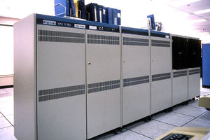
It used to be so simple…
1980’s:
The network was the transmission fabric for computers
It was just a packet transmission facility
Every other function was performed by attached mainframe computers

Slide 3
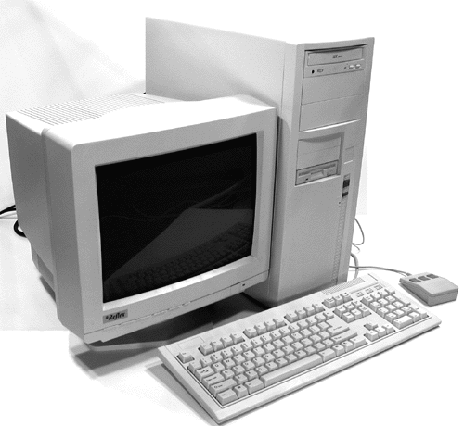

Then we went client/server
1990’s:
The rise of the Personal Computer as the “customer’s computer”
We started to make a distinction between “customers” and “network”
  The naming system was pulled into the network
  The routing system was pulled into the network
  Messaging, content and services were pulled into the network
We created the asymmetric client/server network architecture for the Internet

Slide 4
Internet Infrastructure of 2000
Rapid expansion of infrastructure in many directions:
Exchanges, Peering Points and Gateways
Tier 1 ISPs
Transit and Traffic Engineering
Data Centres and Service “Farms”
Quality of Service Engineering
MPLS, VPNs and related network segmentation approaches
Customer Access Networks
Content Distribution Networks

Slide 5
What’s driving change today?
Bigger
Faster
Better
Cheaper

Slide 6

Bigger
Increasing transmission capacity by using photonic amplifiers and wavelength multiplexing for fibre cables
Adding link aggregation capability
Serving content and service transactions by distributing the load across many individual platforms through server and content aggregation
The rise of high capacity mobile edge networks and mobile platforms add massive volumes to content delivery
To manage this load we’ve stopped pushing content and transactions across the network and instead we serve from the edge

Slide 7

Faster
Reduce latency - stop pushing content and transactions across the network and instead serve from the edge
The rise of CDNs serve (almost) all Internet content and services from massively scaled distributed delivery systems.
“Packet Miles” to deliver content to users has shrunk - that’s faster!
The development of high frequency cellular data systems (4G/5G) has resulted in a highly capable last mile access network with Gigabit capacity
Applications are being re-engineered to meet faster response criteria
Compressed interactions across shorter distances using higher capacity circuitry result in a faster Internet

Slide 8
Better
If “better” means “more trustworthy” and “more privacy” then we are making progress at last!
  Encryption is close to ubiquitous in the world of web services
  TLS 1.3 is moving to seal up the last open TLS porthole, the SNI field
  Oblivious DNS and Oblivious HTTP is moving to isolate knowledge of the querier from the name being queried
  The content, application, and platform sectors have all taken the privacy agenda up with enthusiasm, to the extent that whether networks are trustable or not doesn’t matter any more – all network infrastructure is uniformly treated as untrustable!

Slide 9

Cheaper
We are living in a world of abundant comms and computing capacity
And working in an industry when there are significant economies of scale
And being largely funded by capitalising a collective asset that is infeasible to capitalise individually
The result is that a former luxury service accessible to just a few has been transformed into an affordable mass-market commodity service available to all

Slide 10
So it’s all good!
Right?

Slide 11
Some questions to think about
In a world of private CDN networks does Transit matter any more?
  Or Peering? Or Exchanges? Or Gateways?
  Or are all these infrastructure elements heading inexorably to valueless irrelevance?

Slide 12
Some questions to think about
In a world of private CDN networks does Transit matter any more?
  Or Peering? Or Exchanges? Or Gateways?
  Or are all these infrastructure elements heading inexorably to valueless irrelevance?
In a world of application-based comprehensive end-to-end encryption are there any inspection and interception control points left?
  Or is the entire Internet variously opaque in a diversity of ways that it can now resist the attempt to impose any such points of inspection or control

Slide 13
Some questions to think about
In a world of private CDN networks does Transit matter any more?
  Or Peering? Or Exchanges? Or Gateways?
  Or are all these infrastructure elements heading inexorably to valueless irrelevance?
In a world of application-based comprehensive end-to-end encryption are there any inspection and interception control points left?
  Or is the entire Internet variously opaque in a diversity of ways that it can now resist the attempt to impose any such points of inspection or control
What is left of our former public communications infrastructure?
  And does anyone care any more?

Slide 14
Some questions to think about
In a world of private CDN networks does Transit matter any more?
  Or Peering? Or Exchanges? Or Gateways?
  Or are all these infrastructure elements heading inexorably to valueless irrelevance?
In a world of application-based comprehensive end-to-end encryption are there any inspection and interception control points left?
  Or is the entire Internet variously opaque in a diversity of ways that it can now resist the attempt to impose any such points of inspection or control
What is left of our former public communications infrastructure?
  And does anyone care any more?
Are these changes resistible in any way?
  What’s the cost to a national economy in driving away digital services?
  Or trying to enforce national adherence to compromised and useless crypto models?
  Or trying to isolate points of foreign dependence in the delivery of Internet services?

Slide 15
Some questions to think about
In a world of private CDN networks does Transit matter any more?
  Or Peering? Or Exchanges? Or Gateways?
  Or are all these infrastructure elements heading inexorably to valueless irrelevance?
In a world of application-based comprehensive end-to-end encryption are there any inspection and interception control points left?
  Or is the entire Internet variously opaque in a diversity of ways that it can now resist the attempt to impose any such points of inspection or control
What is left of our former public communications infrastructure?
  And does anyone care any more?
Are these changes resistible in any way?
  What’s the cost to a national economy in driving away domestically sourced digital services?
  Or trying to enforce national adherence to compromised and useless crypto models?
  Or trying to isolate points of foreign dependence in the delivery of Internet services?
Once you pass the entire global communications endeavour to a market-based private sector regime then it takes on a momentum of its own that places it outside of historic forms of national regulation and control
And that’s what we need to come to terms with today!

Slide 16
Thanks!

