Slide 1
IPv6 and Fragmentation
Geoff Huston AM
Chief Scientist, APNIC

Slide 2

I have just a few minutes
So I will skip forward to slide 31
  What follows here in the pack is a quick explanation ofIP fragmentation and why it;s useful and why it doesn’t work!
  The full pack is available here

Slide 3
Fragmentation
IP is one of the few protocols that allowed packets to be fragmented by the network
This has been both a fundamental strength and a major weakness for IP
Lets look at fragmentation in a bit more detail

Slide 4
Before Packets…
Digitised telephone networks switched time
  Each active network transaction was a 56K constant bit rate data stream
  Each stream was divided into 8,000 7 bit samples per second
  Each 7 bit sample was aggregated with other samples and packed into frames
  Each frame was switched at 8K frames per second

Slide 5
Packets are Different
Computers do not require constant bit rate virtual circuits
They can optimise their data rates to make efficient use of the network
They can vary the packet size to match the requirements of the application and the network
They do not rely on a network state – each packet contains information in the header to allow it to be passed to the destination

Slide 6
Packet Networks are Different
The range of packet sizes supported in a network represents a set of engineering trade-offs
  Bit error rate of the underlying media
  Desired carriage efficiency
  Transmission speed vs packet switching speed

Slide 7
Media Packet Sizes
Ethernet 64 – 1,500 octets
  These numbers were derived from the original CSMA-CD design
FDDI 4,532 octets
Frame Relay 46 – 4,470 octets
ATM 53 octets
BER, Framing, FEC (or not), Jitter, HOL blocking, etc all play a role in the design tradeoffs for media packet sizes

Slide 8
Aside: The IEEE Jumbogram Fiasco
1500 octets was fine for 10Mbps
  800 packets per second
But at 100Gbps?
  8,000,000 packets per second
So why not allow for larger packets?
Yes, but what size?
  IEEE found themselves incapable of standardizing which size to pick
  So they ended up picking none!

Slide 9
Packet Protocol Design
EITHER use a fixed packet size approach
  Tends to be a lower number (see ATM)
  Decreases carriage efficiency and increases packet switching loads
OR use a variable size approach
  Maximises applicability
  Maximises carriage efficiency
  But the protocol needs to cope with packet size mismatch as a packet traverses multiple networks

Slide 10
IPv4 Packet Design
FORWARD fragmentation
  If a router cannot forward a packet on its next hop due to a packet size mismatch then it is permitted to fragment the packet, preserving the original IP header in each of the fragments

Slide 11
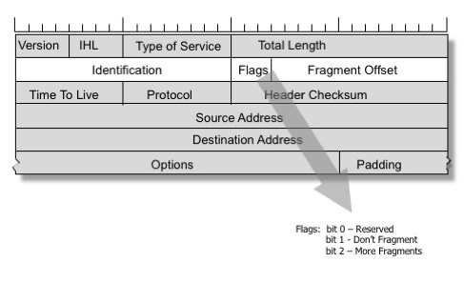
IPv4 Fragmentation Control

Slide 12
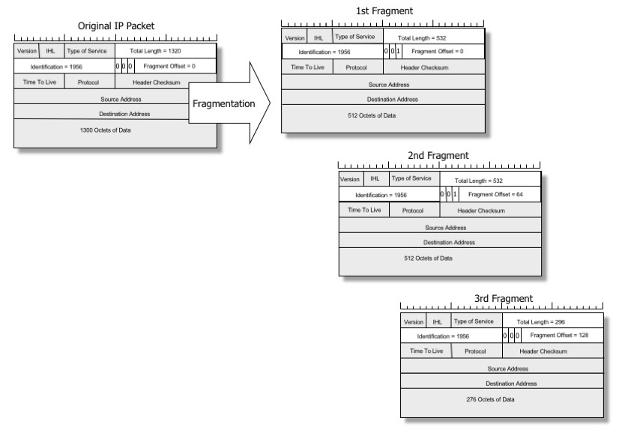
IPv4 Fragmentation

Slide 13
IPv4 and “Don’t Fragment”
If Fragmentation is not permitted by the source, (by setting the Don’t Fragment bit) then the router discards the packet. The router may send an ICMP to the packet source with an UnReacahble code (Type 3, Code 4)
Later IPv4 implementations added a MTU size to this diagnostic ICMP message to indicate how to repair the problem
ICMP messages are extensively filtered in the Internet, so applications should not count on receiving these ICMP messages

Slide 14
Trouble at the Packet Mill
Lost frags require a resend of the entire packet
The 16-bit identification field represents a ceiling to the number of packets in flight for high-speed high-latency systems
Fragments represent a problem to firewalls
  without the transport headers (which are only in the leading fragment) it is unclear whether subsequent frags should be admitted or denied
Fragments represent a massive problem to ECMP per-flow load balancers
Packet reassembly consumes resources at the destination

Slide 15
The thinking at the time…
Fragmentation was, all things considered, a net Bad Idea!
Kent, C. and J. Mogul, "Fragmentation Considered Harmful", Proc. SIGCOMM '87 Workshop on Frontiers in Computer Communications Technology, August 1987

Slide 16
IPv6 Packet Design
Attempt to repair the problem by effectively jamming the DON’T FRAGMENT bit to ON
  Which effectively prohibits on-the-fly fragmentation by intermediate switches

Slide 17
IPv6 Packet Design
Attempt to repair the problem by effectively jamming the DON’T FRAGMENT bit to ON
IPv6 uses BACKWARD signalling
  When a packet is too big for the next hop a router should send an ICMP6 TYPE 2 (Packet Too Big) message to the source address and include the MTU of the next hop.

Slide 18
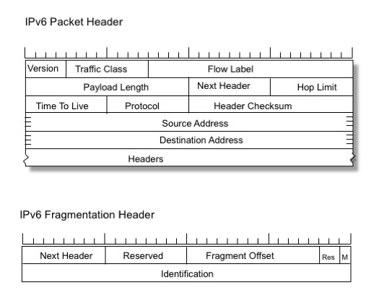
IPv6 Source Fragmentation

Slide 19
What changed? What’s the same?
All IPv4 packets have Fragmentation Control fields.
Only Fragmented IPv6 packets have IPv6 Extension headers added to the packet
IPv4 sources and routers may generate fragments
Only IPv6 sources may fragment a packet
Both protocols support a “Packet Too Big” ICMP diagnostic signal from the interior of the network to the source

Slide 20
What does “Packet Too Big” mean anyway?
errrrr

Slide 21
What does “Packet Too Big” mean anyway?
Clearly the packet was too big to be delivered, and this is a notice to the sources to that effect
All well and good, but what is the source meant to do then?

Slide 22
It’s a Layering Problem
Fragmentation was seen as an IP level problem
  It was meant to be agnostic with respect to the upper level (transport) protocol
But we don’t treat it like that
  And we expect different transport protocols to react to fragmentation notification in different ways

Slide 23
What does “Packet Too Big” mean anyway?
For TCP it means that the active session referred to in the ICMP payload* should drop its session MSS to match the MTU, and re-send unacknowledged data **, ***
  i.e. you should never see IPv6 fragments in TCP!
    * IPv4: assuming that the payload contains the original IP + TCP headers
    ** assuming that the ICMP is genuine
    *** and if that’s too hard, set a per destination MTU value from the ICMP and hope that the TCP session is able to get itself out of its wedged state and resend the data within the new MTU

Slide 24
What does “Packet Too Big” mean anyway?
For UDP its not clear:
  The offending packet has gone away!
  Some IP implementations appear to ignore it *
  The host should add an entry to the local IP forwarding table that records the MTU that should be used to send future packets to this destination
* This is bad!!!

Slide 25

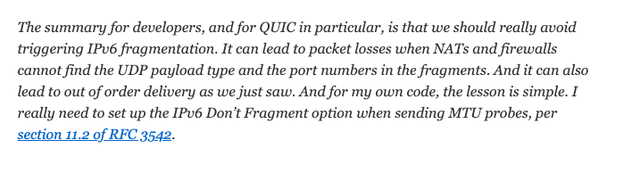
What does “Packet Too Big” mean anyway?
For QUIC:
https://huitema.wordpress.com/2018/03/03/having-fun-and-surprises-with-ipv6/

Slide 26
Problems
ICMP is readily spoofed:
  An attacker may send a fragment stream with a maximum fragment offset value causing a potential memory starvation issue on the destination
  An attacker may send partially overlapping fragments
  An attacker may spoof ICMP PTB messages with very low MTU values
  An attacker may spoof a stream of ICMP PTB messages with random IPv6 source addresses

Slide 27
Problems
ICMP is widely filtered
  leading to black holes in TCP sessions
    GET is a small HTTP packet
    The response can be arbitrarily large, and if there is a path MTU mismatch the response can wedge
Get
Response

Slide 28
Problems
ICMP is widely filtered
  Leading to ambiguity in UDP
    Is UDP packet loss due to congestion or MTU mismatch?
    Should I give up, resend or revert to TCP?

Slide 29
Problems
Backward signalling is unreliable
  In no other part of the IP protocol is it assumed that the source address of an IP packet is reliably reachable by anything other than the addressed destination
  Source addresses are not necessarily “real”
    MPLS
    IP tunnels
    SDN

Slide 30
IPv6 Fragmentation: Adding an Extension Header
Extension Headers are a problem
  A number of implementations of network level packet processing equipment appears to be intolerant of IPv6 packets with Extension headers – so they drop them!
  IPv6 Fragmentation Control is an Extension Header
  Today’s network has a significant level of drop of IPv6 packets with fragmentation extension headers

Slide 31
Now to Measurements…

Slide 32
How serious is this problem?
How bad is fragmentation loss in IPv6?
How bad is Extension Header loss in IPv6?

Slide 33
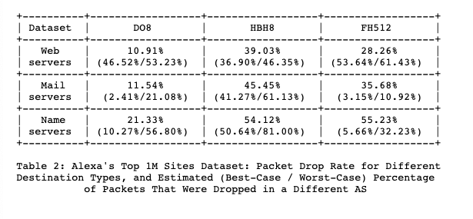
Initial Tests: 2014 (RFC 7872)
August 2014 and June 2015
Sent fragmented IPv6 packets towards “well known” IPv6 servers (Alexa 1M and World IPv6 Launch
Drop Rate:

Slide 34
APNIC Test – August 2017
Use APNIC IPv6 measurement platform to test the drop rate of IPv6 packets flowing in the opposite direction (server to client)
That’s 21%
This is an improvement over the RFC7872 measurement, but its still a really bad number!

Slide 35
APNIC Test - 2021
Re-work of the 2017 measurement experiment
  Same server-to-client TCP session fragmentation mechanism
  Uses a middlebox to fragment outgoing packets - drop is detected by a hung TCP session that fails to ACK the sequence number in the fragmented packet
  This time we randomly vary the initial fragmented packet size between 1,200 and 1,416 bytes
  Performed as an ongoing measurement

Slide 36
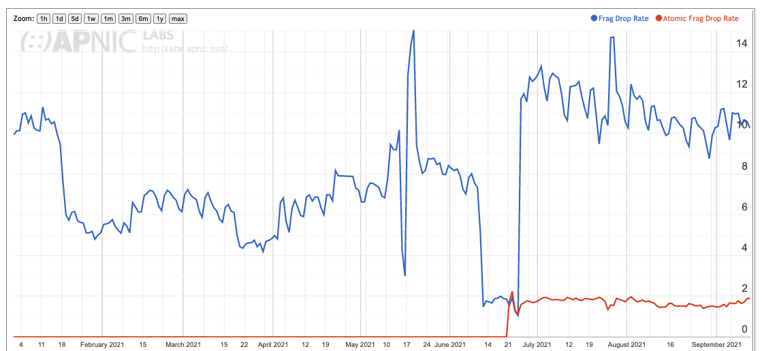
2021 Fragmentation Drop Rate
This is a significant improvement over 2017 data
Since 2017 there are 10x the number of IPv6 users and the fragmentation drop rate has halved – we appear to be getting better at handling IPv6 fragments!

Slide 37
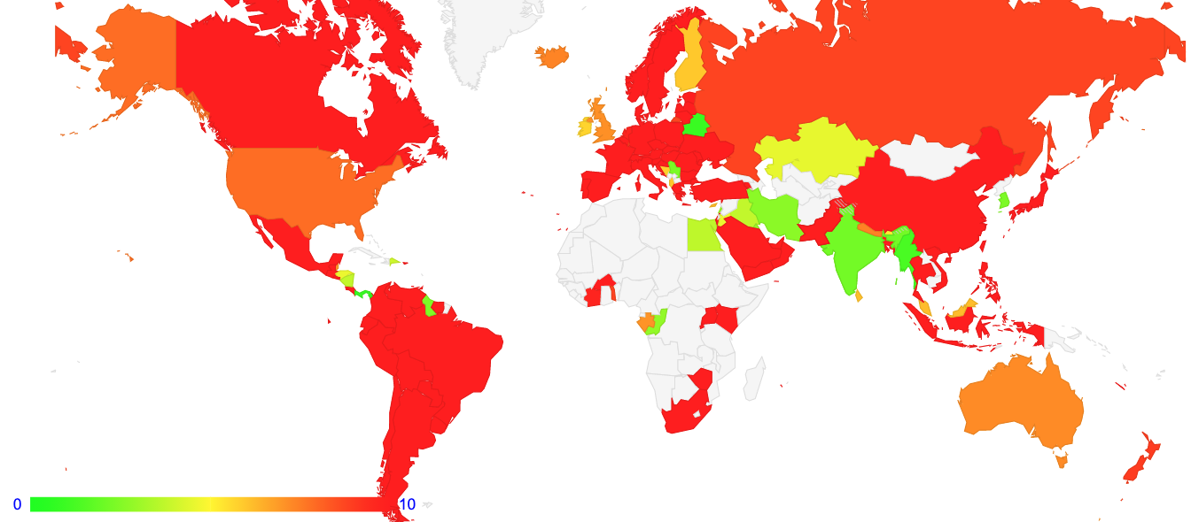
2021 Fragmentation Drop Rate
More recent IPv6 deployments appear to be a lot better than more mature ones

Slide 38
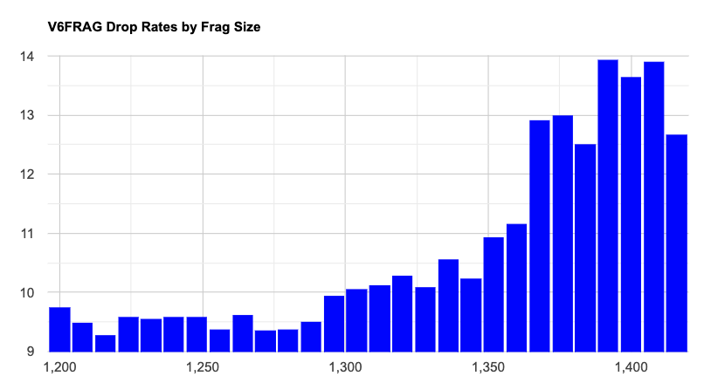
Drop Rate by Size
This is unexpected. At a total IPv6 packet size of 1408 bytes we did not expect to see higher packet drop rates for this packet size, as there is still an IP encapsulation budget of 92 bytes

Slide 39
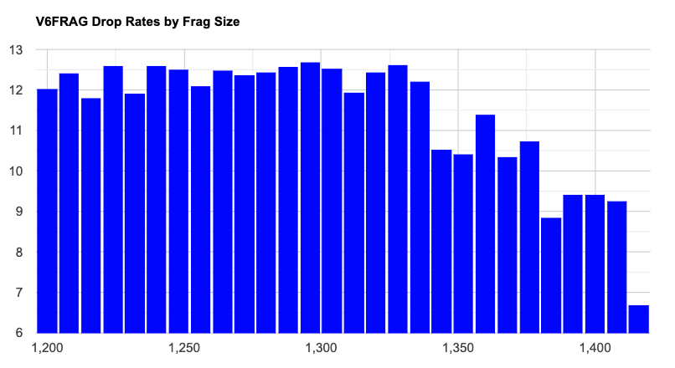
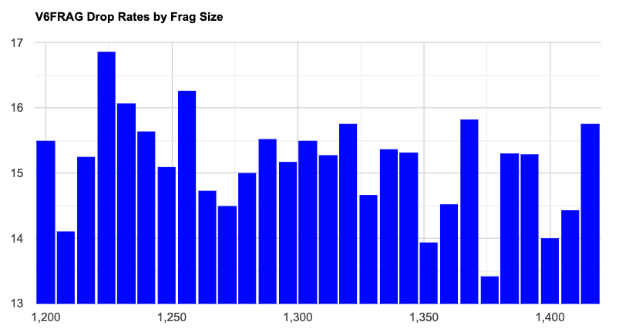
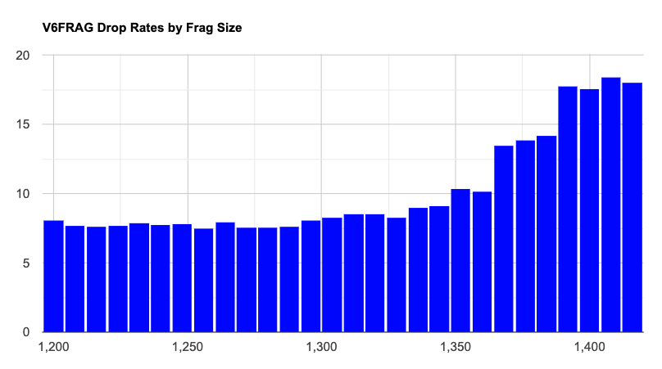
Drop Size Profile by Region
Americas
Europe
Asia

Slide 40
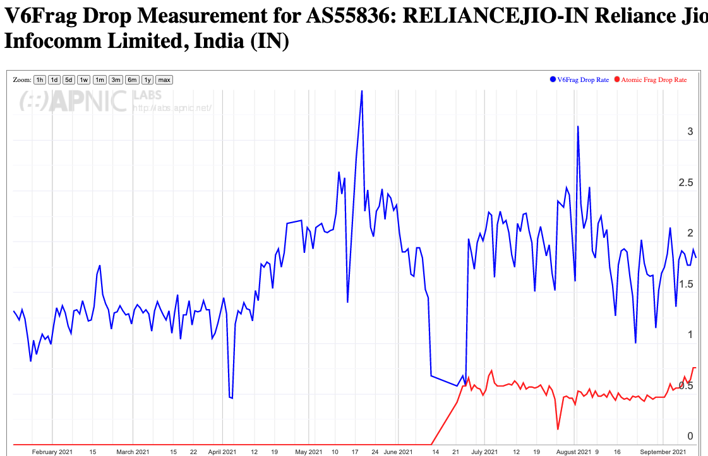
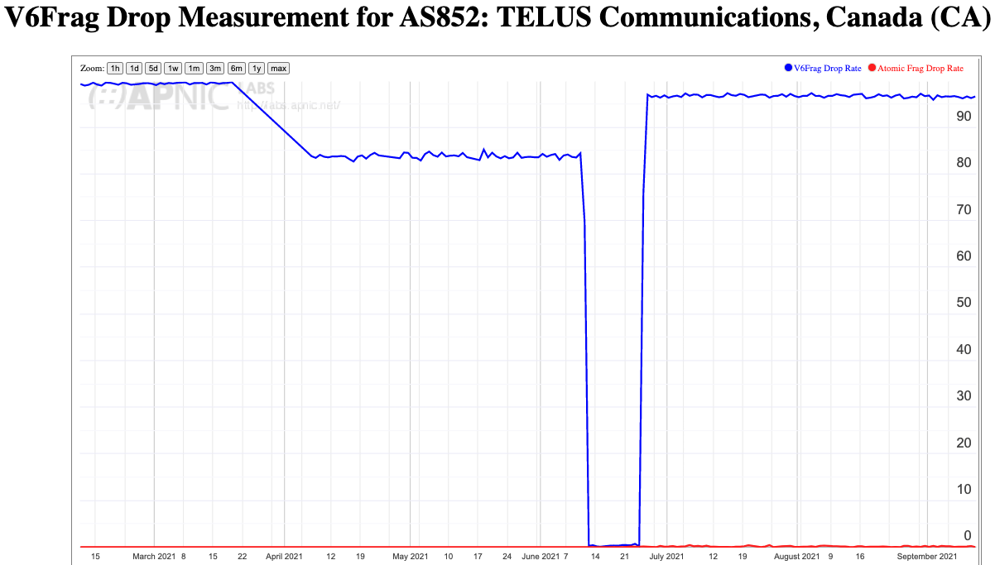
Why?
Drop patterns vary across service providers, so there are probably contributary factors from network equipment and configurations
80% Drop
2% Drop

Slide 41
Why?
Other potential factors that could contribute:
Local security policies
IPv6 EH may trigger “slow path” processing in network equipment that could lead to higher drop rates
IPv6 Path MTU woes!

Slide 42
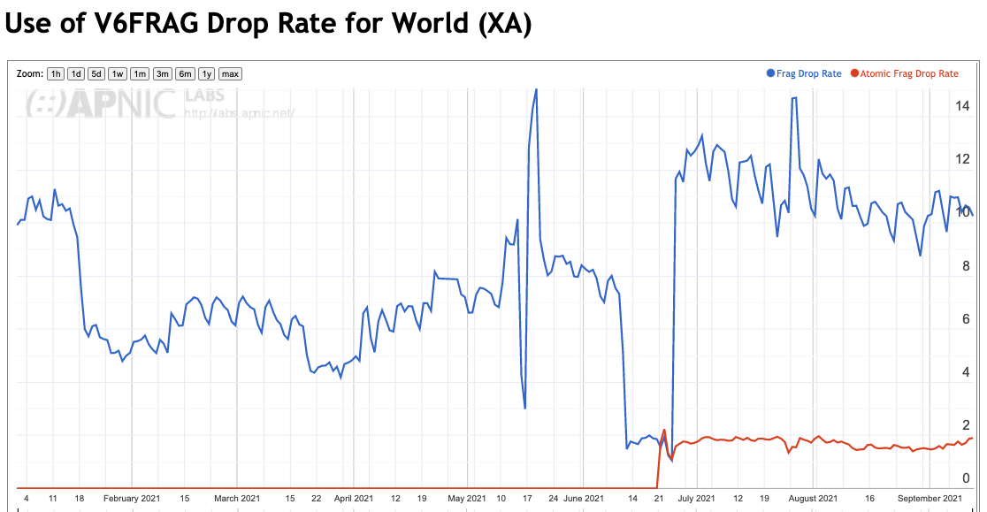
”Atomic” Fragments
It’s possible to add a “null” Fragmentation Extension header to a IPv6 packets
Atomic Frag Drop rate is 2%

Slide 43
The Atomic Frag Drop rate varies by region and by provider
Europe – 8%
Americas - 0.5%
Asia – 1%
AS3320 (DTAG, Germany) – 22%
AS7922 (Comcast, US) – 0.3%
AS55836 (Reliance Jio, India) - 0.3%
AS54113 (Fastly) - 95%

Slide 44
Why?
Some possible explanations…
  Different dual stack transition architectures appear to have different behaviours with fragmentation and extension header handling
  Different use of LAG / ECMP approaches are variably tolerant of trailing frags with no transport header
    The IPv6 Flow Label was meant to address this, but…
  Differing security stances with respect to fragment forwarding
  Different vendor equipment handles IPv6 packets differently
    And ISPs don’t appear to care about a uniform handling setup across ISPs!
    Because Dual Stack and fallback to IPv4 fixes everything – right?

Slide 45
Summary
The IPv6 network is improving it’s handling of fragmented packets
In 5 years its gone from unusably bad to tolerably poor in average, but terrible in some places
Recent IPv6 deployments appear to show more robust handling of IPv6 packets
  Older IPv6 infrastructure appears to be less tolerant of both fragments and extension headers
Smaller frags appear to be more robust than larger ones (if you are going to fragment a packet, prefer smaller fragment sizes, not larger ones)

Slide 46
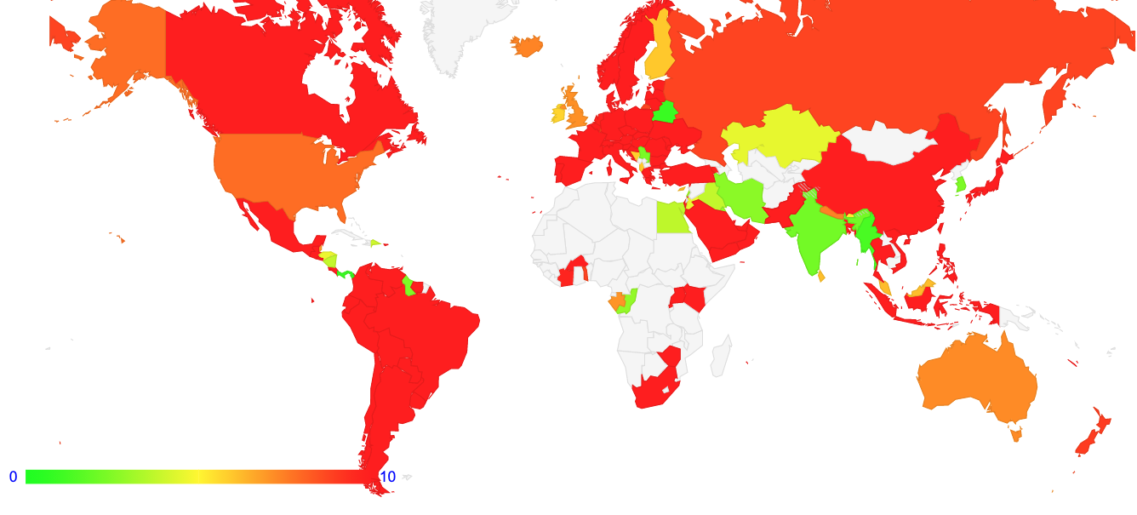

Daily Report
https://stats.labs.apnic.net/v6frag

Slide 47
That’s it!

