Slide 1
The resolvers we use
Geoff Huston
João Damas
APNIC Labs

Slide 2
As far as we are aware nobody actually said this:
"In the EU the DNS resolvers we use are dominated by a service operated by an American behemoth that is completely unaccountable to EU users and operates entirely outside of our regulatory framework.
And they are operating an essential piece of Internet infrastructure that many EU Internet users rely on.
We feel that this is unacceptable situation for the EU.”
But when we look at the possible political motivations behind the DNS4EU initiative it sure feels like this is a credible explanation!

Slide 3
“The resolvers we use”
What does this mean?
If you wanted to conduct a measurement experiment to calculate the “user share” of DNS resolvers, then what exactly should be measured?
And once you have that measurement, then what is the data telling us?

Slide 4
Our Initial thoughts
Use Ads to send each user a unique DNS name to resolve. We look at the authoritative server and collect the IP address of the resolvers asking the authoritative server, and use Ad data to match this query to an end user IP address
user
Recursive Resolver
Authoritative Server
Measurement
Ad placement data
<ID, IPaddr>
DNS query data
<ID, DNS resolver IPaddr>

Slide 5
More Initial Thoughts
The Authoritative Server always answers queries immediately with the A / AAAA records as requested
The data is unsigned and the responses fit comfortably within 512 octets of DNS payload
We try to minimise timeouts and requeries by steering users to a DNS Authoritative server that is (roughly) on the same continent as the user

Slide 6
More Initial thoughts
We need to map the resolver “helper” addresses to a resolver service
  Which back-end DNS addresses are used by each open resolver?
  RIPE Atlas helped here for those cases where the open resolver operator does not publish this information
We map resolvers into a number of categories based on the resolver’s IP address:
  Resolver is in the same AS as the end user
  It’s a known Open DNS resolver
  Resolver is geo-located to the same CC as the end user
  Resolver is geo-located to a different CC from the end user

Slide 7
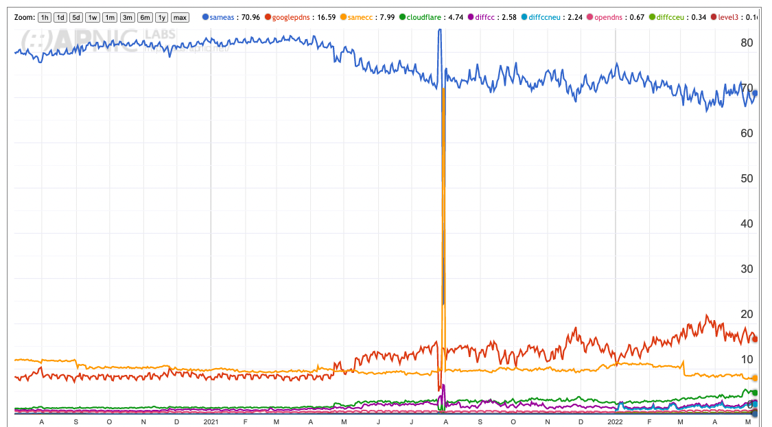
DNS resolver use in EU region
Resolvers seen from a single initial query
Same AS (ISP) – 70%
Google – 16%
Same CC – 8%
Cloudflare – 5%
2021
2022
https://stats.labs.apnic.net/rvrs/XE?hc=XE&hl=1&hs=0&ht=10&w=1&t=10&s=2

Slide 8
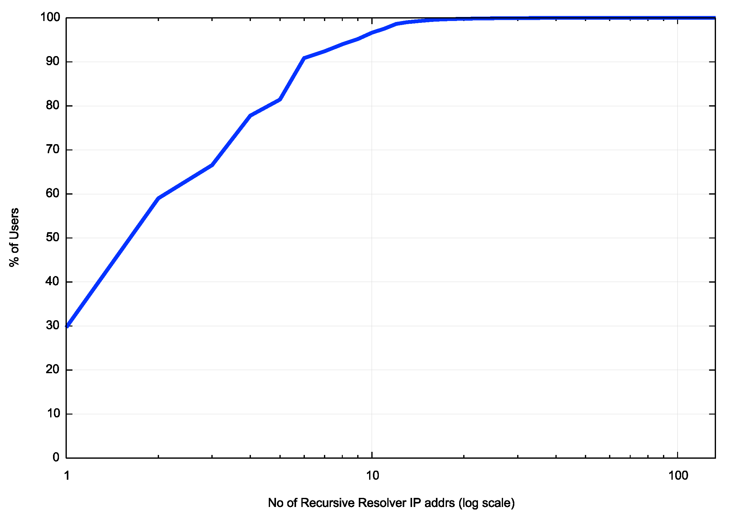
However, its not as simple as it may suggest
We observe that this single initial query generates 1 or more queries from a single recursive resolver IP address just 30% of the time
2 or more different resolvers are queried in 60% of cases
Most of the time (90% of cases) these multiple resolver IP addresses are all in the same AS
Cumulative Distribution of number of resolver IP addresses seen to query for a unique DNS name

Slide 9
Multiple resolvers “see” individual stub queries
We see an average of 3.23 distinct resolver IP addresses at the authoritative server for each queried domain name within the first 15 seconds
What should we do with these “extra” DNS queries?
In this case we just add them to the count
Could we do better?

Slide 10
What are we measuring here?
Seems that this experiment is not clear about what is being measured
So we thought that maybe we really wanted to know all the resolvers who might see your query
But to flush out all of these resolvers we need to adjust this experiment

Slide 11
Second Thoughts
Get the authoritative server to return SERVFAIL all the time
This way the stub resolver is likely to cycle through all the locally configured recursive resolvers to find a non-SERVFAIL DNS response

Slide 12
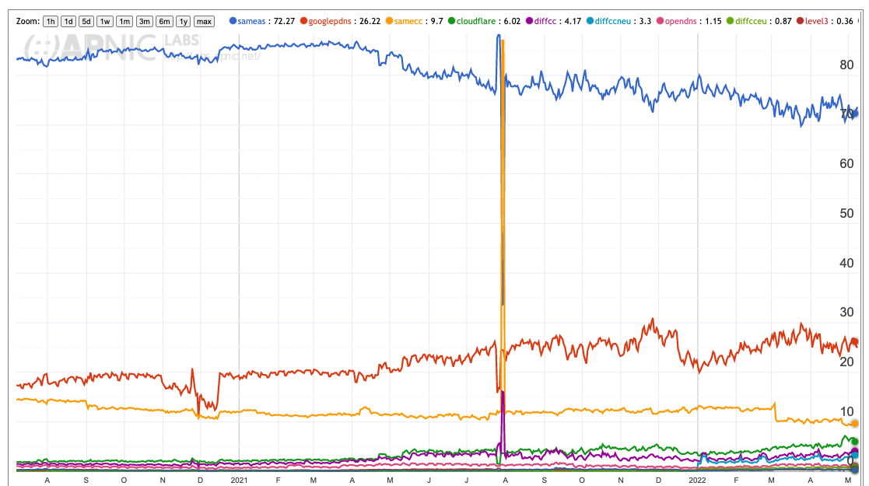
DNS in EU
All Resolvers seen
from SERVFAIL
Same AS (ISP) – 72%
Google – 26%
Same CC – 9%
Cloudflare – 6%
2021
2022
https://stats.labs.apnic.net/rvrs/XE?hc=XE&hl=1&hs=2&ht=10&w=1&t=10&s=1

Slide 13
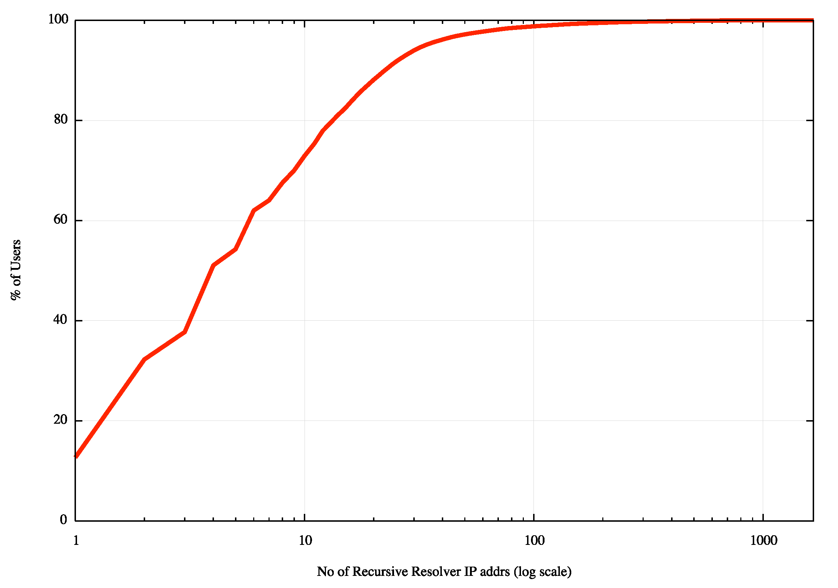
How many resolvers see the query now?
Cumulative Distribution of number of resolver IP addresses seen to query for a unique DNS name
when the response is SERVFAIL
We observe that this single initial query generates 1 or more queries from a single recursive resolver IP address just 12% of the time
2 or more different resolvers are queried in 30% of cases
Most of the time (75% of cases) these multiple resolver IP addresses are all in the same AS

Slide 14
Are we there yet?
No, not really
Perhaps it is also useful to understand which resolver provides the response that the user will use

Slide 15
Third Pass
Single query – same as Pass 1
But only record the first query at the auth server for each unique ID
  We assume that the first recursive resolver to ask the auth server is the first to provide a response to the stub resolver
How does this change the measurements?

Slide 16
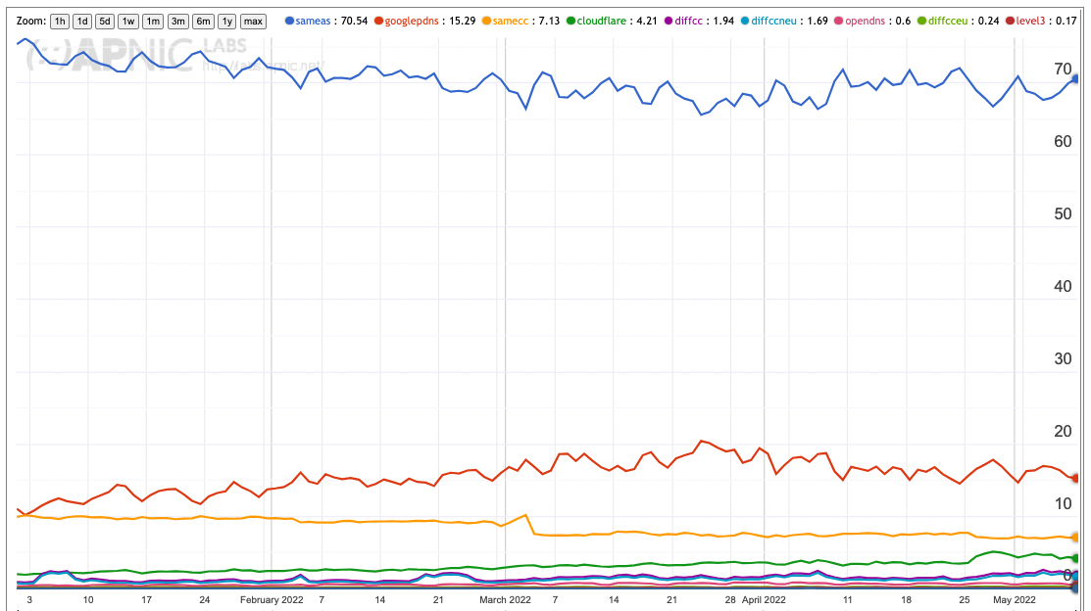
DNS in EU
First Responder
Resolver
Same AS (ISP) – 71%
Google – 15%
Same CC – 7%
Cloudflare – 4%
2022
https://stats.labs.apnic.net/rvrs/XE?hc=XE&hl=1&hs=1&ht=10&w=1&t=10&s=0

Slide 17
Where are we now?
All configured Resolvers Resolvers in the initial query set First Responder
Same AS 72% 70% 71%
Different AS 9% 8% 7%
Google 26% 16% 15%
Cloudflare 6% 5% 4%
What’s Google’s market share of DNS resolution in EU? 26%? Or 15%

Slide 18
Who is “we”?
Ads are directed to all kinds of end points
  There are various forms of Enterprise and B2B networks that are measured as well a consumer networks. These enterprise endpoints have a different DNS profile as compared to consumer retail services, as they tend to be more intensive users of open DNS resolver services than we see in consumer networks.
What if the “we” we are referring to in this measurement are individual consumers in the EU region?
What happens if we filter the ad data for Europe to look only at what we believe are consumer retail ISPs?

Slide 19
DNS in EU
First Responder,
Consumer ISPs
Same AS (ISP) – 87%
Same CC – 6%
Google – 4%
Cloudflare – 1%
2022

Slide 20
Where are we now?
All Resolvers Initial query set First Responder Consumer ISPs
Same AS 72% 70% 71% 87%
Different AS 9% 8% 7% 6%
Google 26% 16% 15% 4%
Cloudflare 6% 5% 4% 1%
Most consumers simply follow the ISP provider’s default settings

Slide 21
What does all this mean?
Most users of retail ISPs use their ISP-provided resolver (same AS)
Some additional users in those ISPs use resolvers in different networks (ASN) but same country
  This can be due to the ISP having services across different ASNs
The picture for enterprise networks is slightly different.

Slide 22
What we didn’t measure
How many different DNS resolver service operators process DNS queries?
  Many ISPs are contracting their DNS resolution functions to a third party
    For example, Nominum is a significant player in this space
  This is subtly different question to just a count of the open DNS resolvers, as we would need to look inside each ISP to identify how they provision their DNS resolution service
Who on-sells query log data or just passes the query logs onto others?
  Again, this is not something that we can measure directly
  Previously we’ve looked at the persistence of DNS queries over time

Slide 23
More hard-to-measure questions
Who retains DNS queries?
  Obviously this is not easy to tell
  But we can look at the distribution of the time gap between the time original query and the recycled query

Slide 24
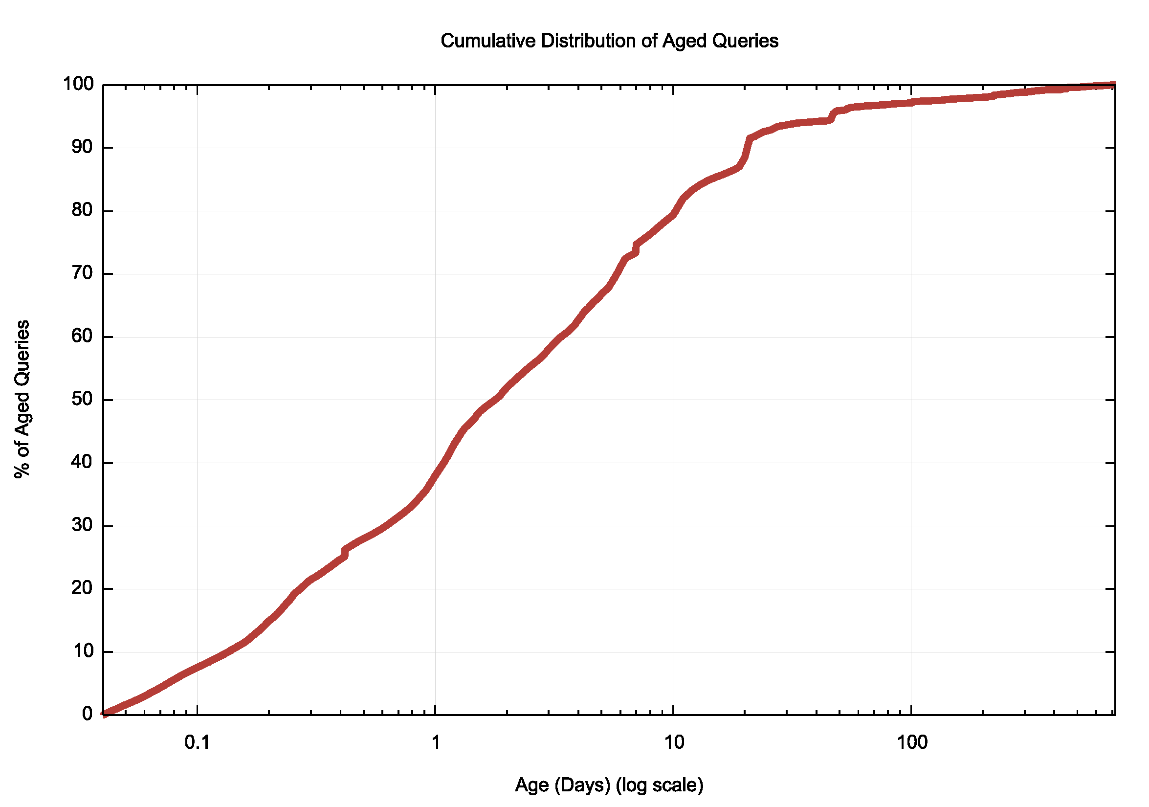
Re-Query distribution
In a 24 hour period we received 612M DNS queries, or which 23M were for names which were “older” than 1 hour
50% of queries for aged names were between 1 and 12 days old
The DNS names are single use names
The DNS responses have a TTL of 60 seconds
Why do we get a 4% query retention and re-query rate?

Slide 25
So, is there really a problem for the EU?
“Yes and No” or perhaps “No and Yes”
The majority of end users use the ISP-provided default in the EU region
However, there is an undeniable issue about the emergence of aspects of centrality in DNS resolution that should be a concern for us all

Slide 26
Questions?

