Slide 1
What happened to IP addresses in 2022?
Geoff Huston
Chief Scientist, APNIC

Slide 2
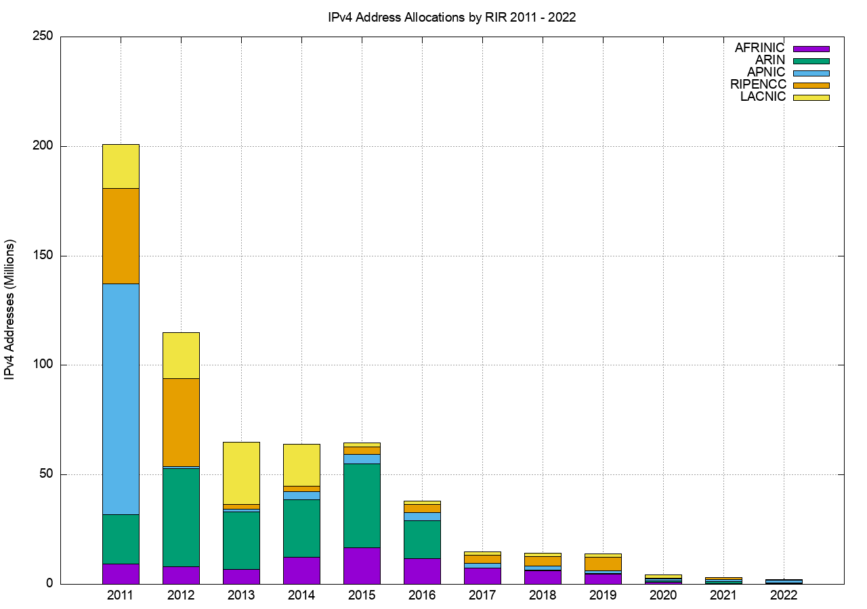
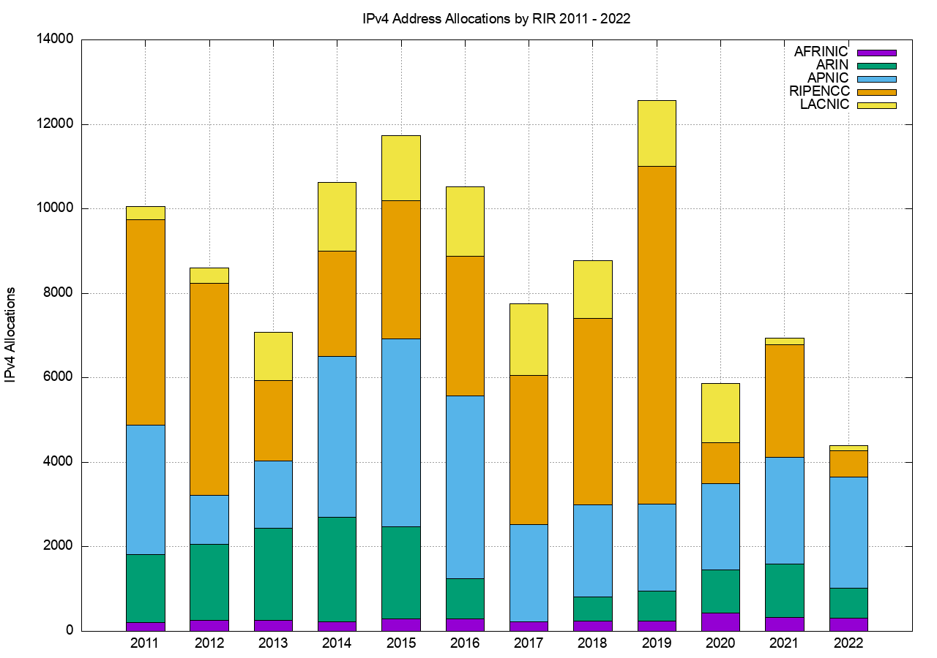
IPv4 Address Allocations
Addresses
Allocations

Slide 3
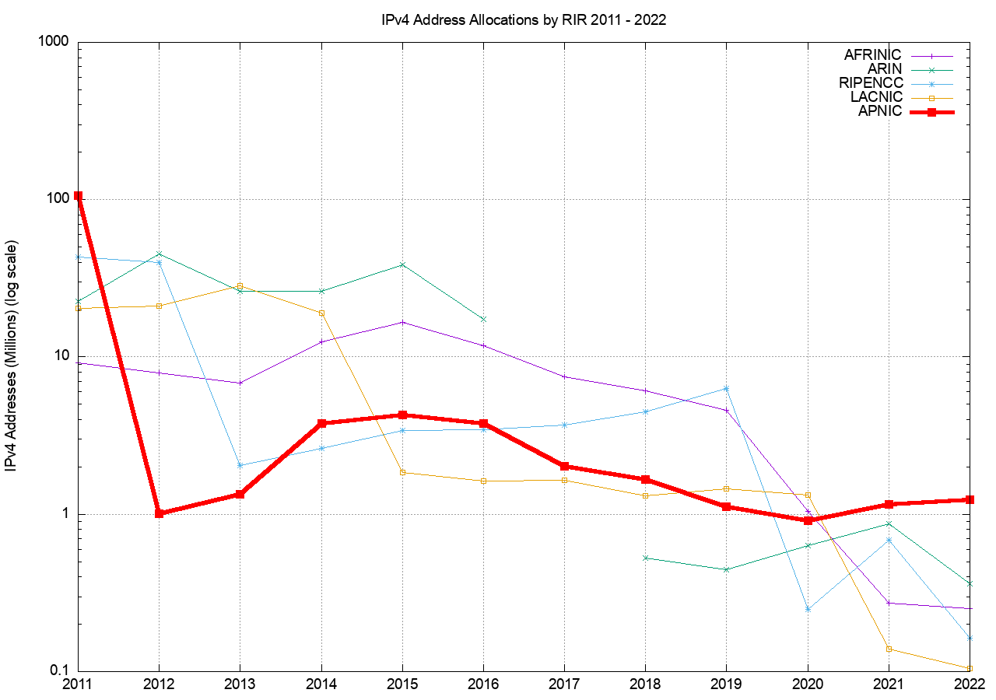
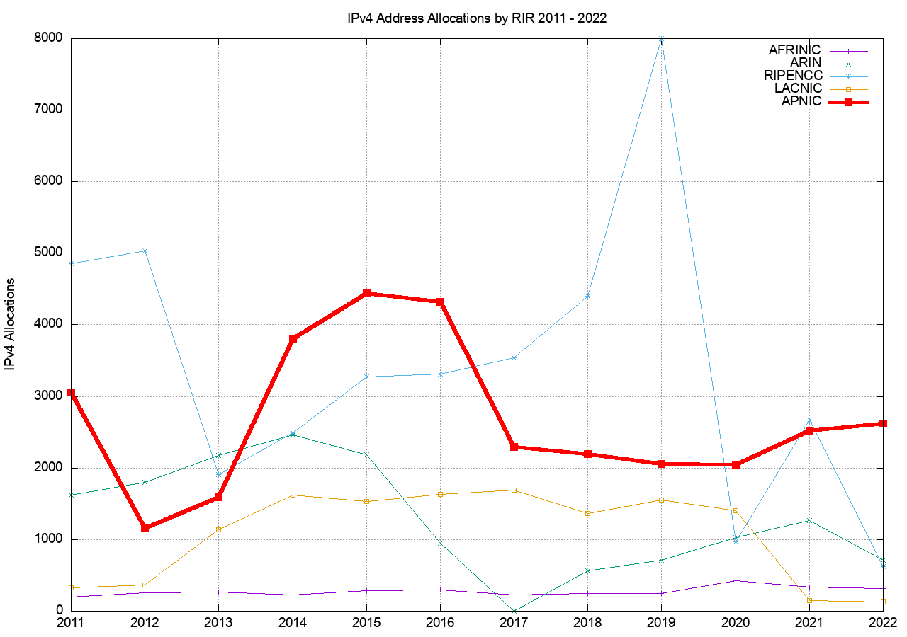
IPv4 Address Allocations
Addresses
Allocations
Notes:
APNIC had sustained a higher IPv4 address allocation rate, both in addresses and allocation transactions compared to the other RIRs over 2022

Slide 4
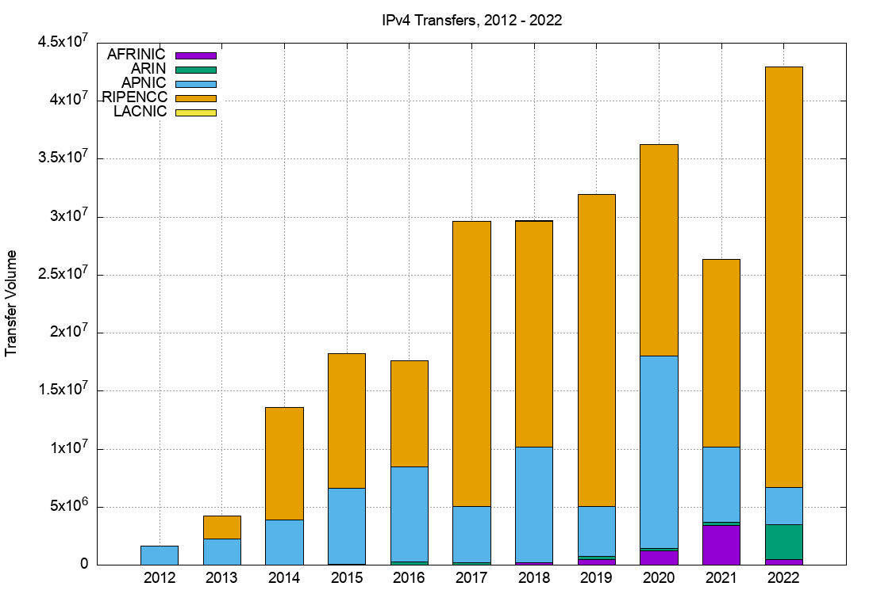
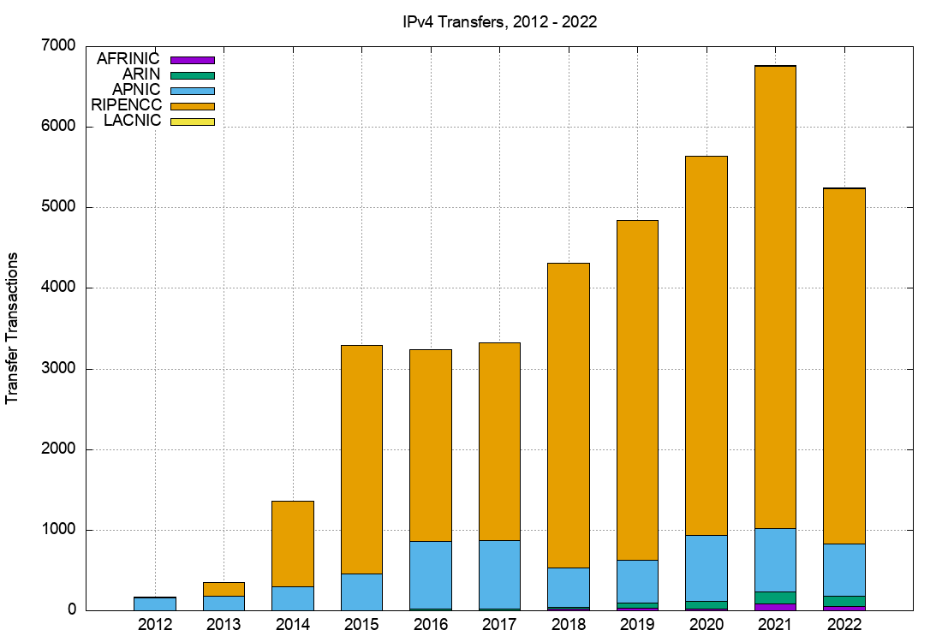
IPv4 Address Transfers
Addresses
Transfers

Slide 5
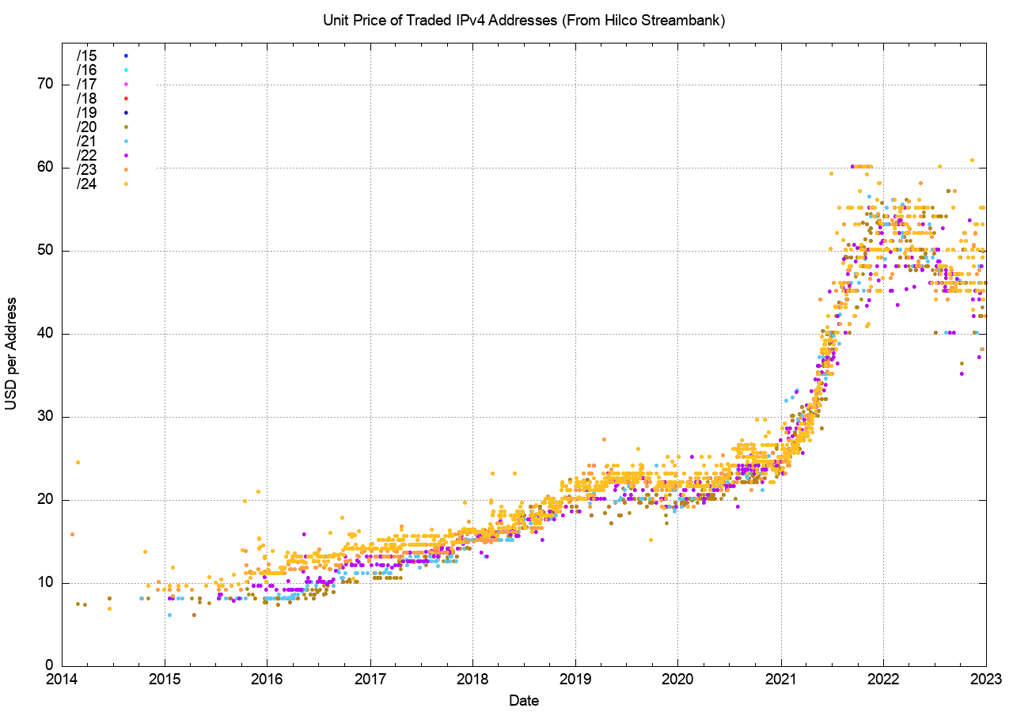
Transfer Pricing
The market price per address doubled across 2021
The average price dropped by 20% across 2022
The variance in prices has increased significantly in 2022

Slide 6
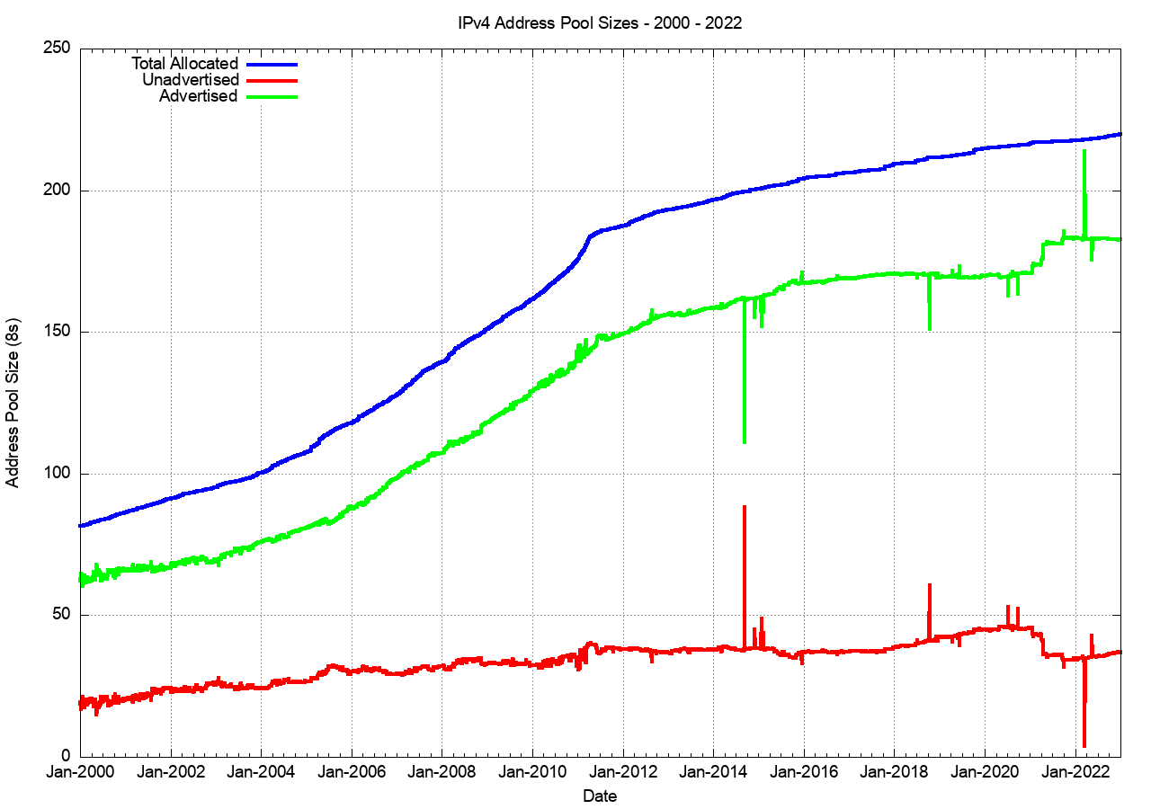
Are Transfers recovering unused addresses?
Allocated Address Pool
Advertised Address Pool
Unadvertised Address Pool

Slide 7
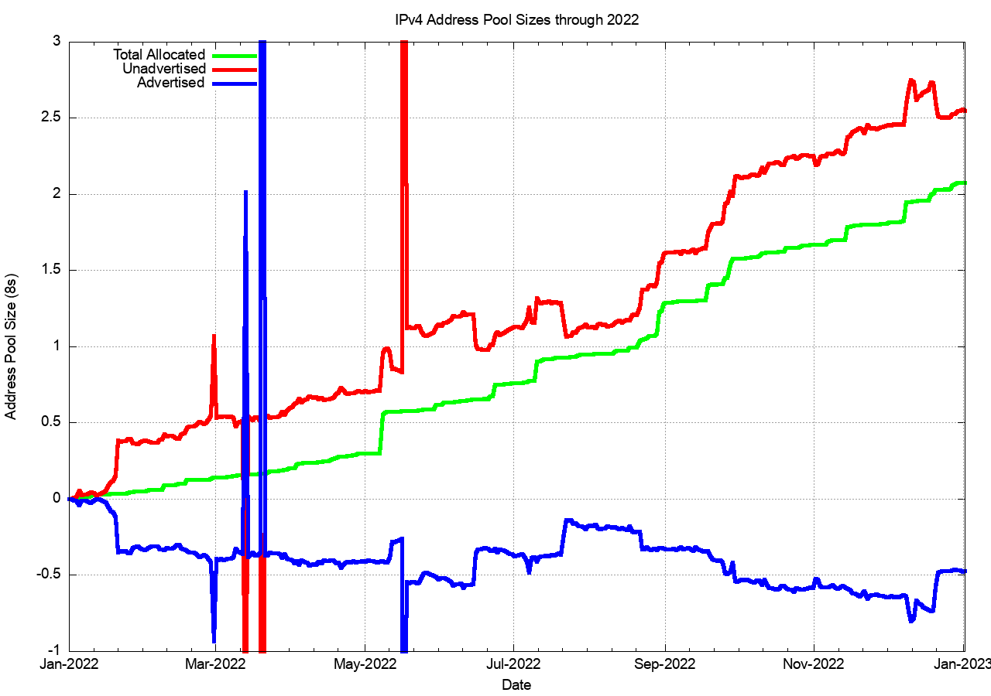
Are Transfers recovering unused addresses?
Unadvertised Address Pool
+9.4M addresses
Allocated Address Pool
+1.5M addresses
Advertised Address Pool
-7.9M addresses

Slide 8
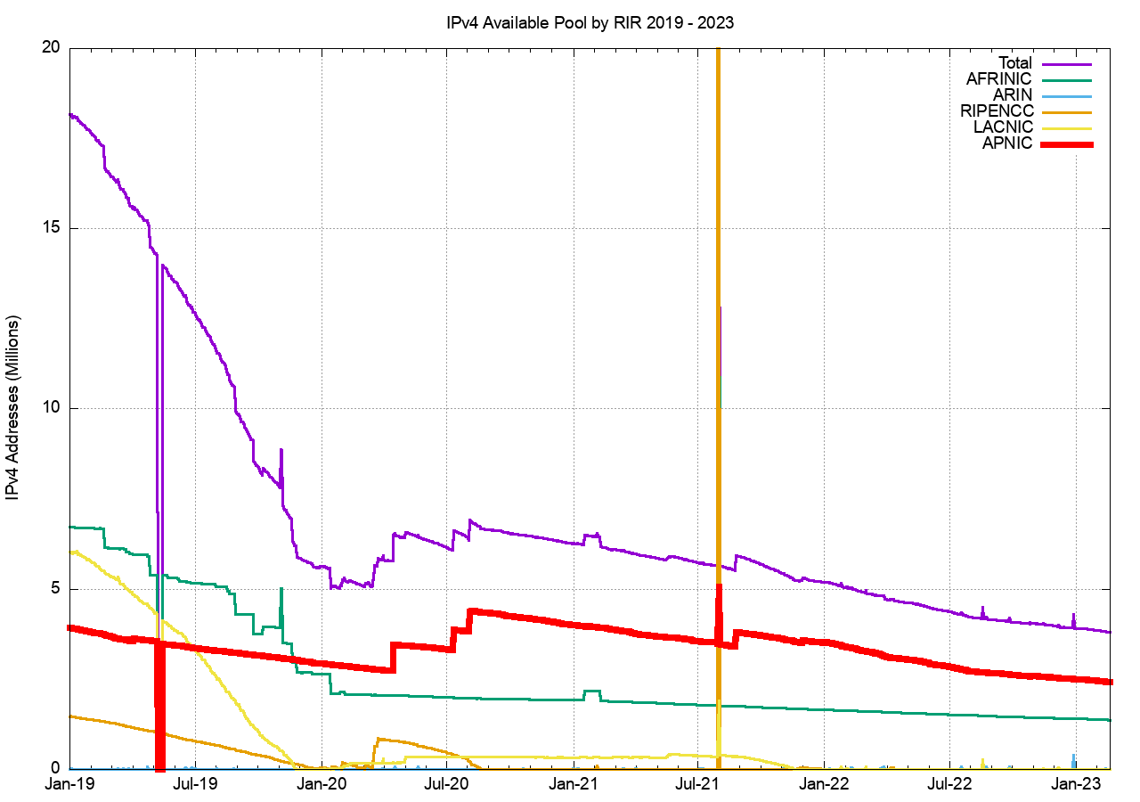
RIR “Available” Address Pools
APNIC
AFRINIC
ARIN
LACNIC
RIPE NCC

Slide 9
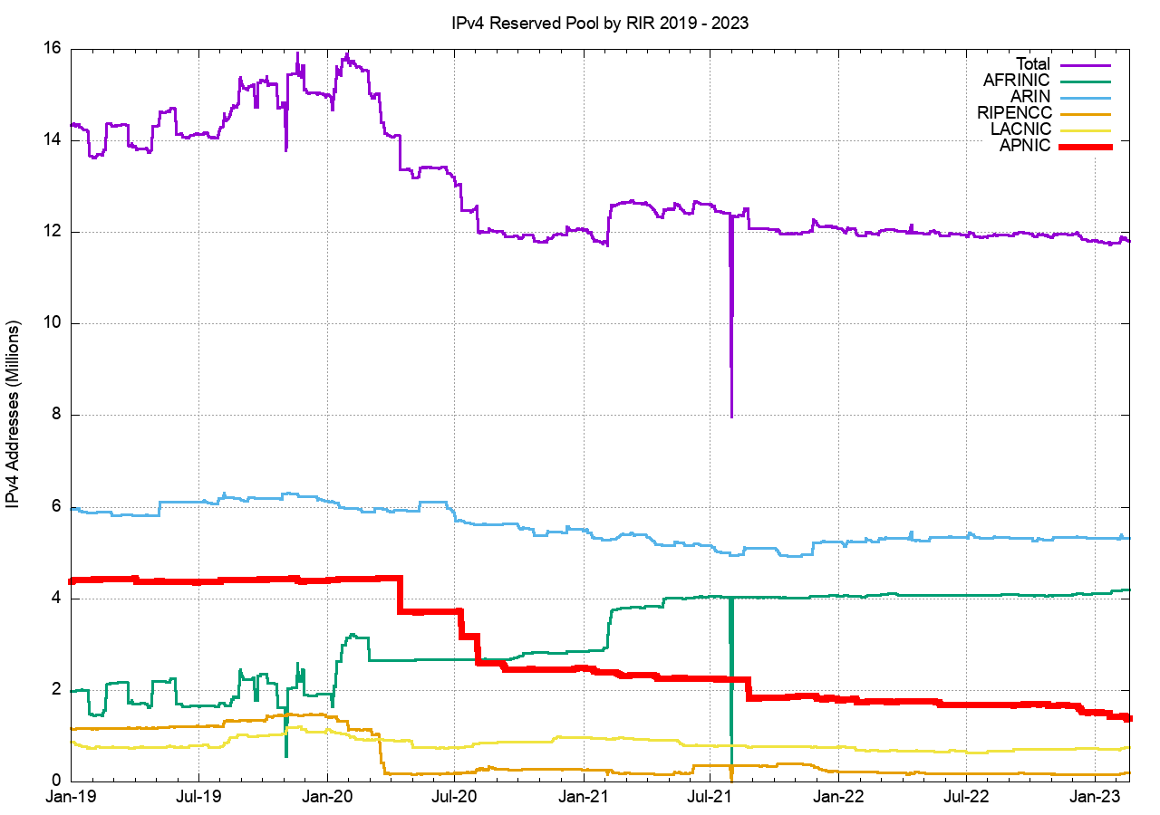
RIR “Reserved” Address Pools
ARIN
AFRINIC
APNIC
LACNIC
RIPE NCC

Slide 10
IPv4 in 2022
Scarcity pressure appears to have reduced in 2022:
  More IPv6-accessible service deployments relieving IPv4 NAT pressures for ISPs
  Lower market prices for IPv4 addresses
  Lower pressure to release unadvertised addresses
  No common perception of imminent collapse of IPv4 markets

Slide 11
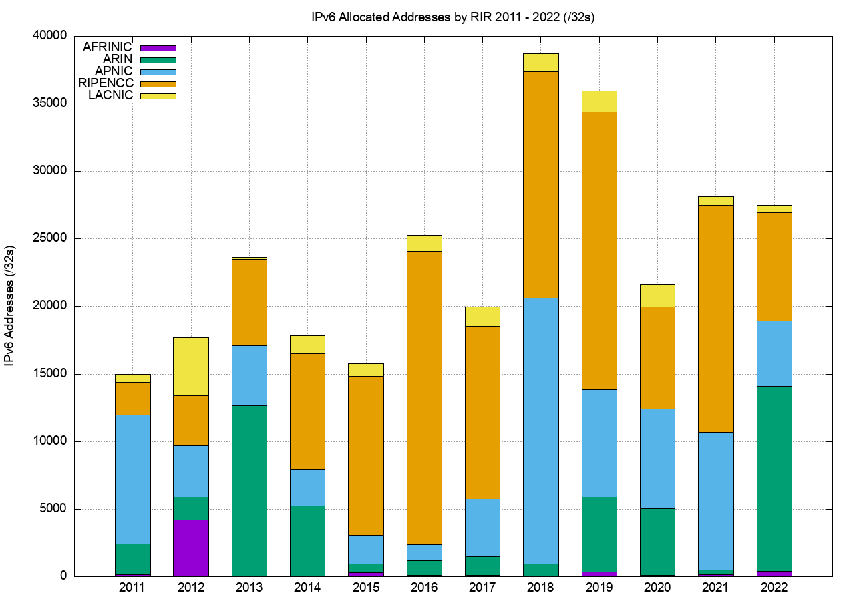
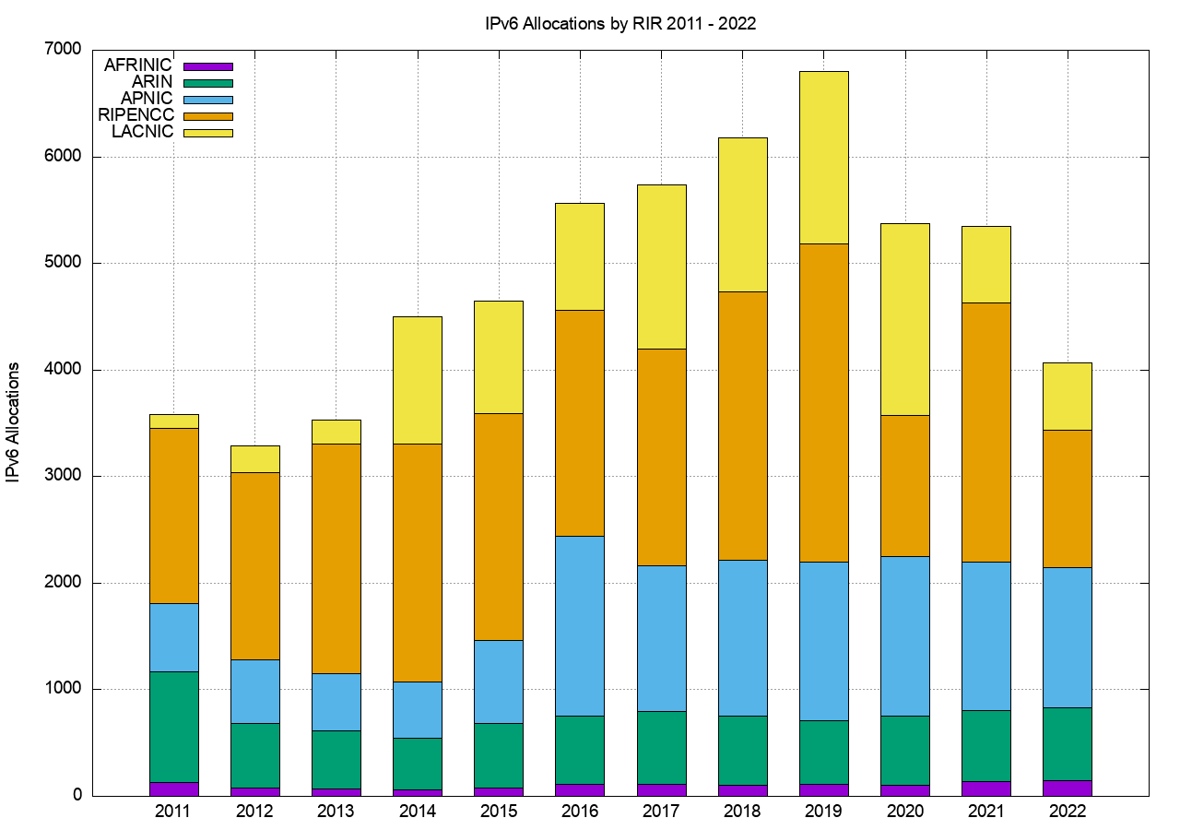
IPv6 Address Allocations
Addresses
Allocations

Slide 12
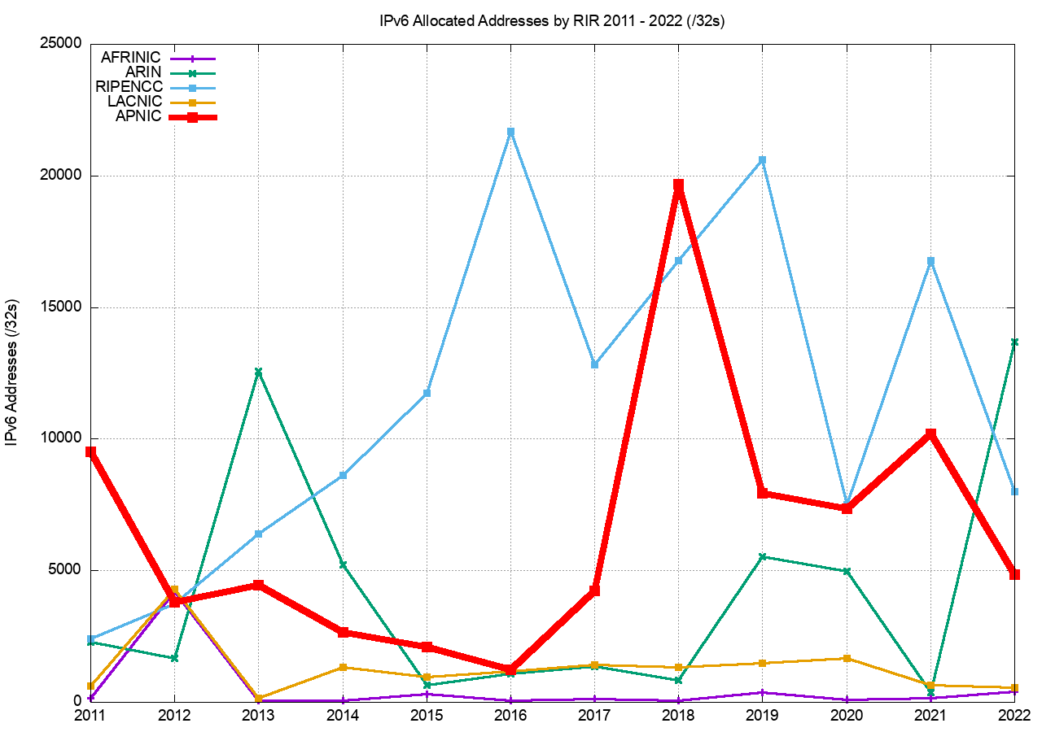
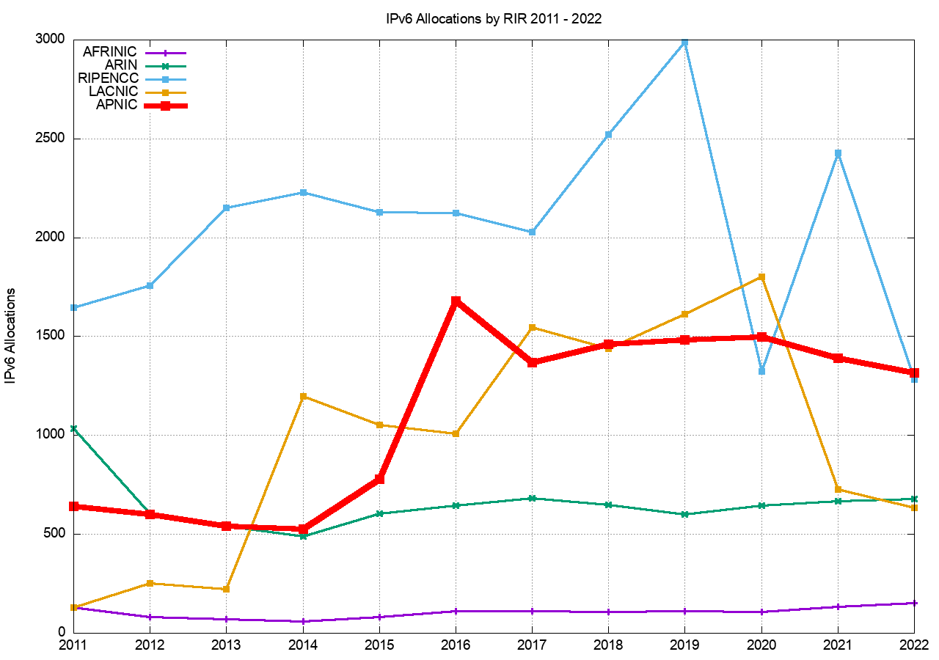
IPv6 Address Allocations
Addresses
Allocations

Slide 13
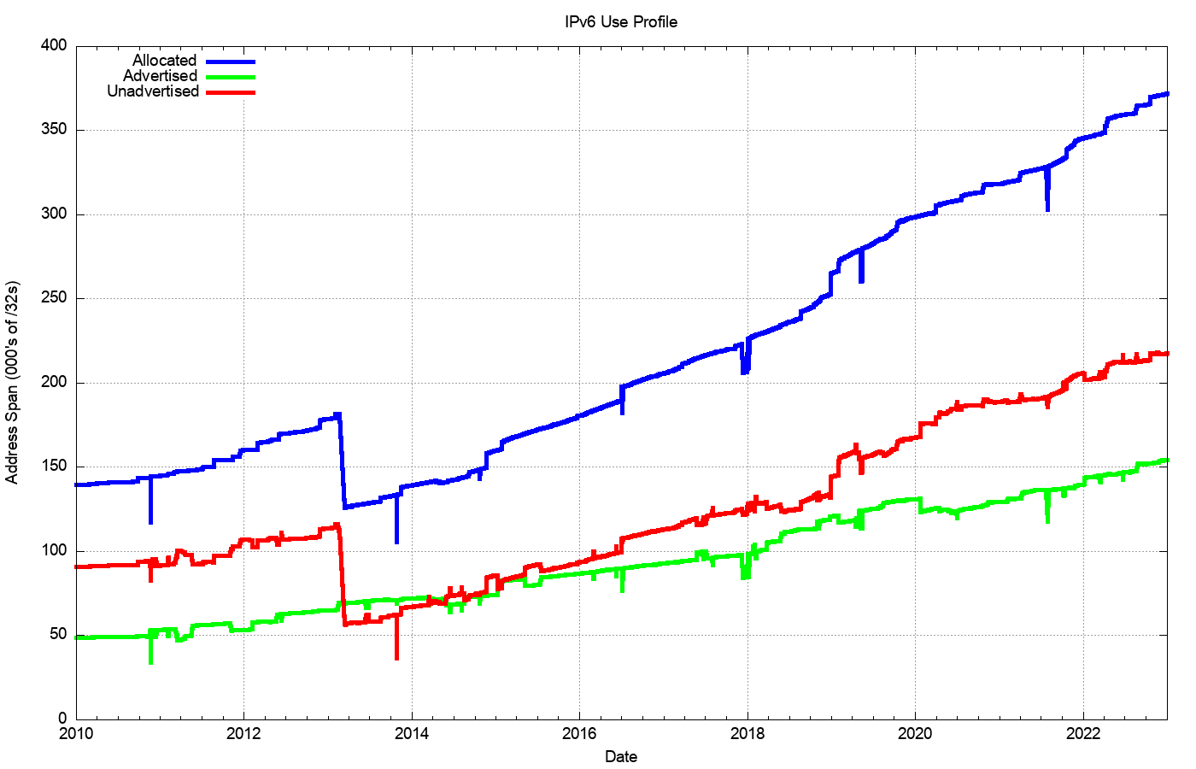
IPv6 Address Pools
Allocated Address Pool
Unadvertised Address Pool
Advertised Address Pool

Slide 14
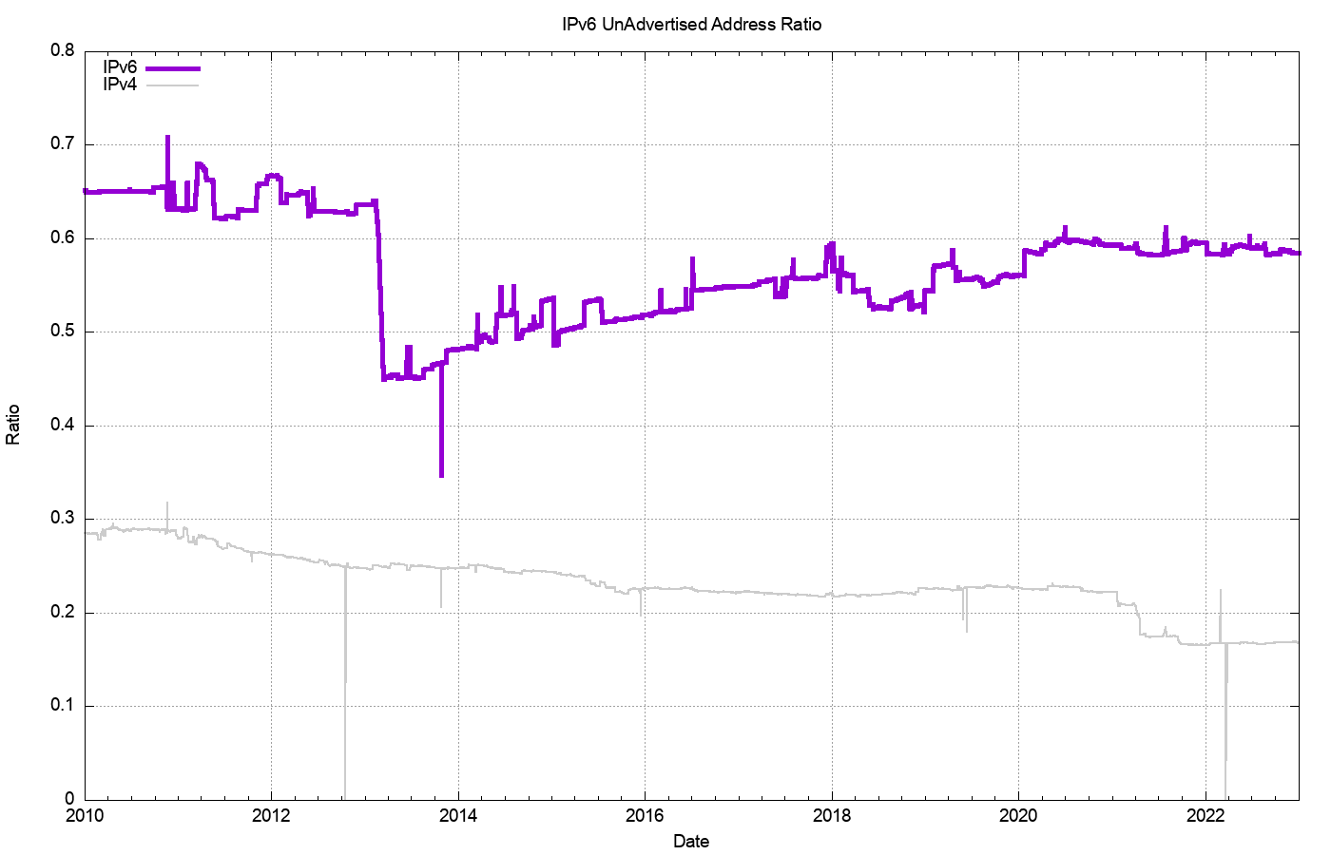
Unadvertised : Advertised Ratio
IPv6
IPv4

Slide 15
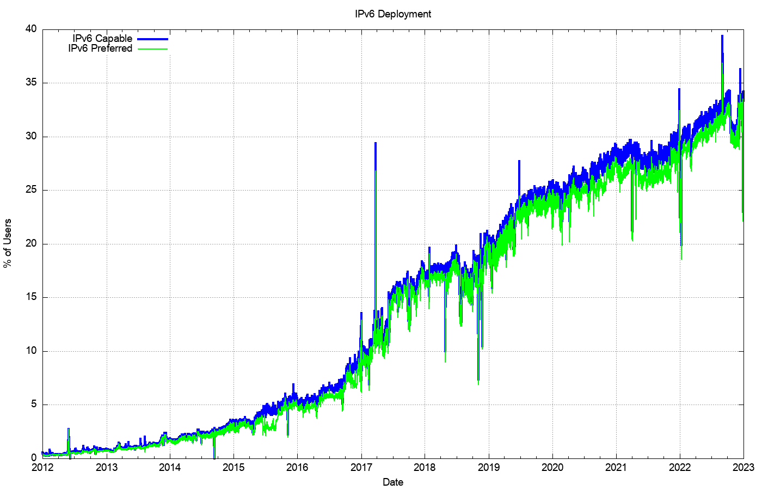
IPv6 Deployment

Slide 16
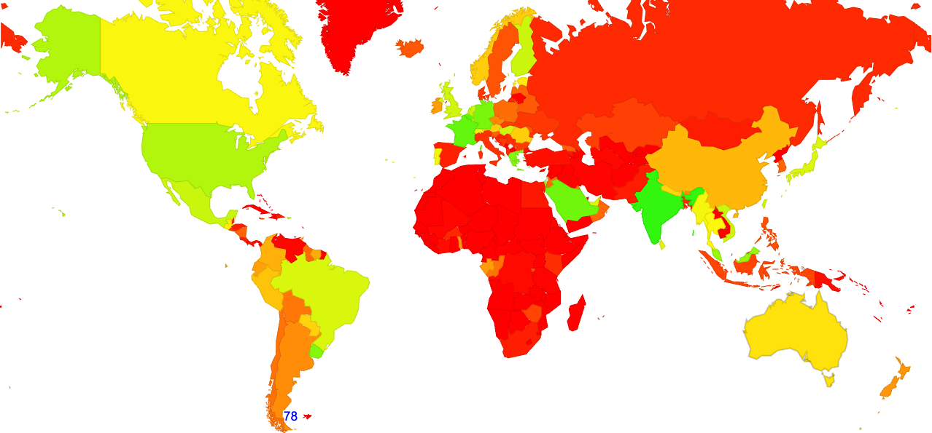
IPv6 Deployment

Slide 17
IPv6 in 2022
Steady IPv6 deployment in access networks is allowing more services to operate in dual stack mode
This is relieving pressure on the IPv4 address pools
Large allocations in IPv6 mean that there is no pressure to deploy IPv6 using highly efficient deployments

