Slide 1
30 years of BGP
Geoff Huston, APNIC

Slide 2
Why?
There are very few ways to see all of the Internet, all at once
Routing is one of the few technologies that attempts to flood everything to everyone all the time!
So what can routing tell us?

Slide 3
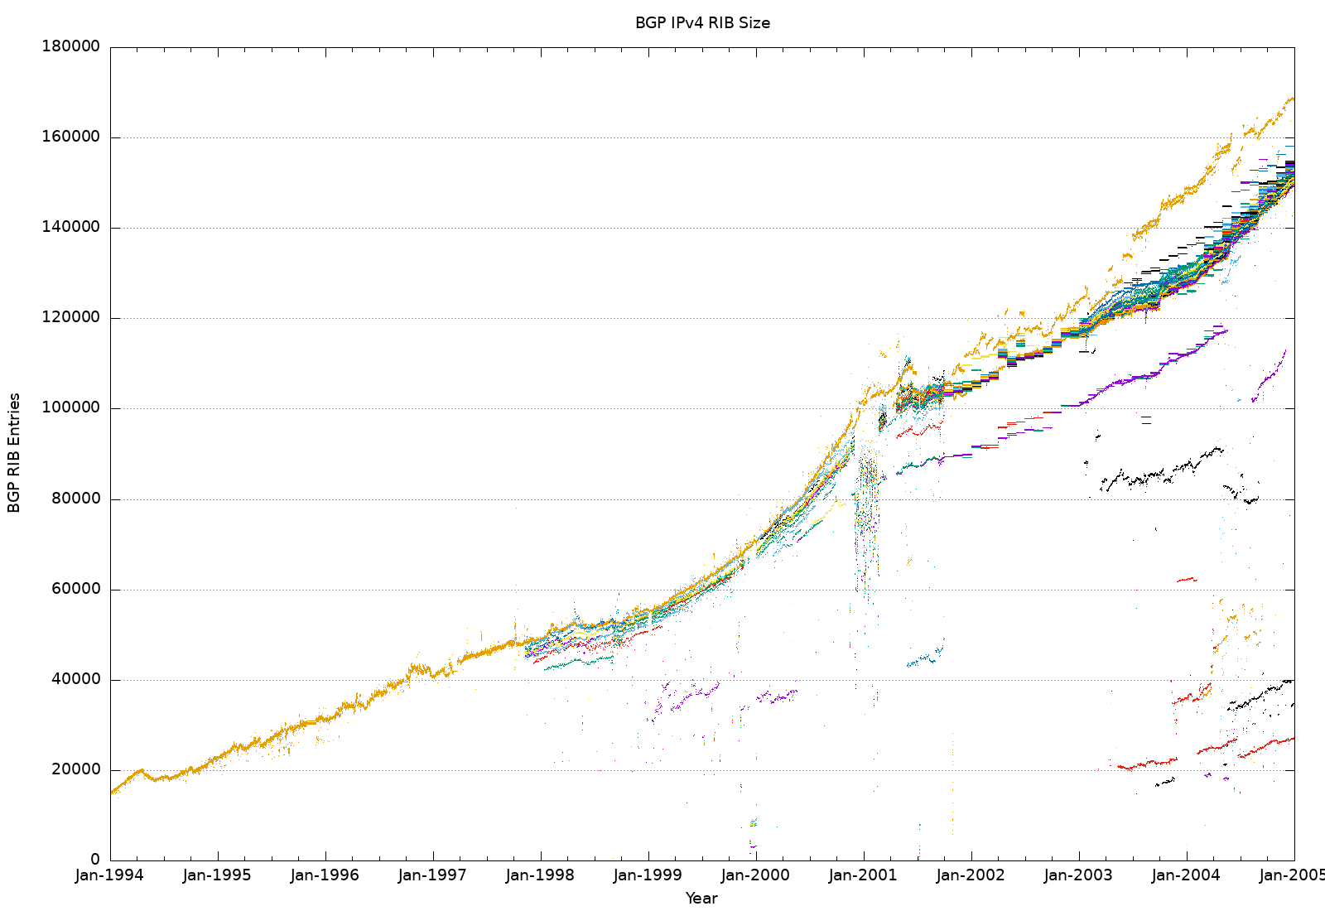
1995 to 2005 – the Internet Consumer Boom!

Slide 4
1995 to 2005 – the Internet Consumer Boom!
Resumption of exponential growth
The Boom and Bust of 2001

Slide 5
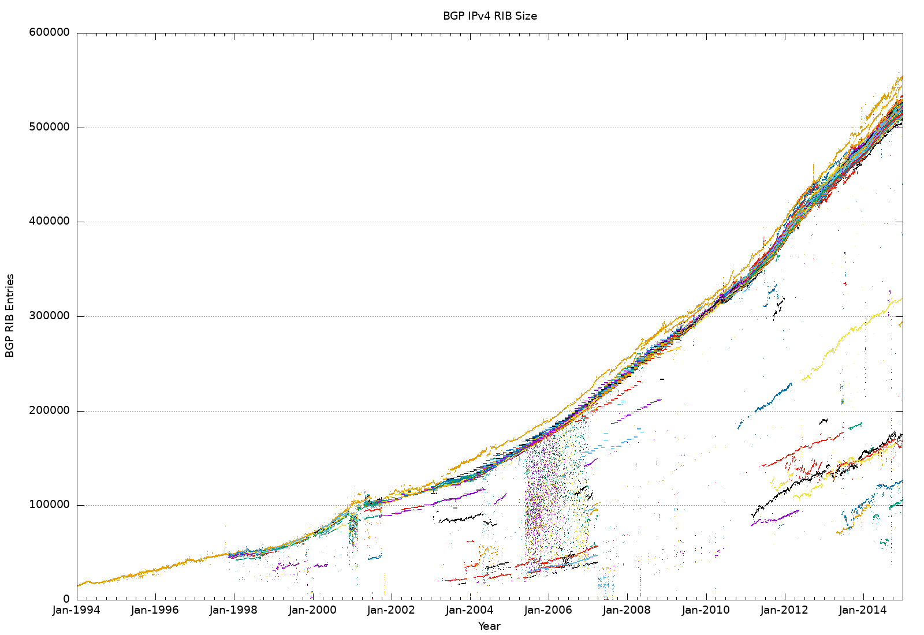
2005 to 2015 – Peak IPv4

Slide 6
2005 to 2015 – Peak IPv4
RIRs exhaust their IPv4 pools

Slide 7
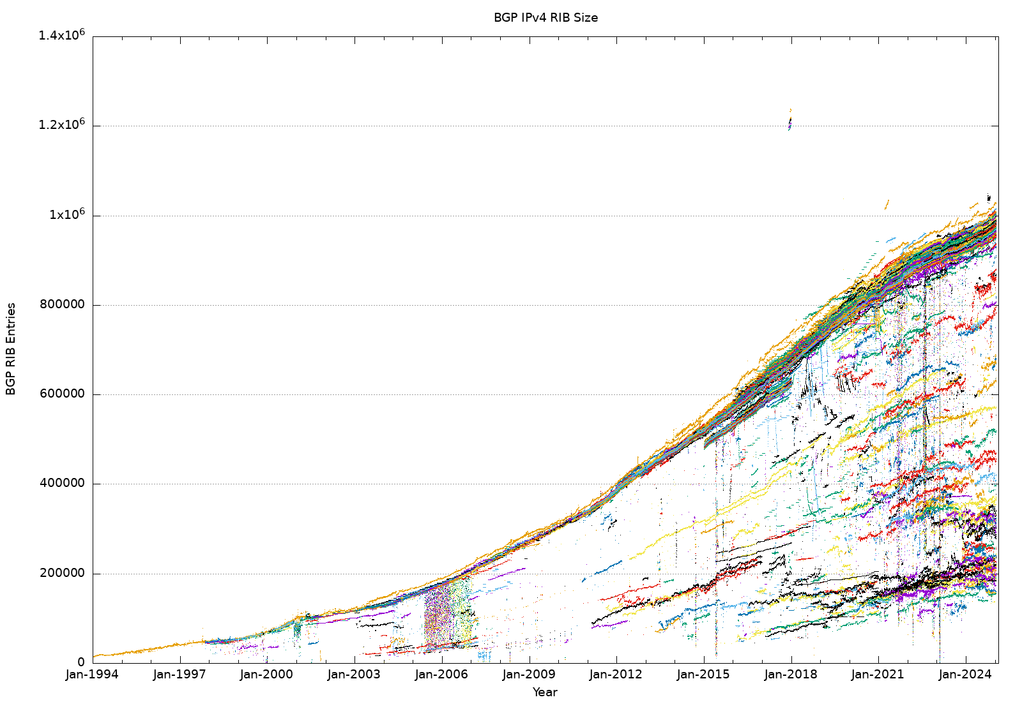
Up to 2025 – Post Peak IPv4

Slide 8
Up to 2025 – Post Peak IPv4
IPv4 growth model abruptly stops

Slide 9
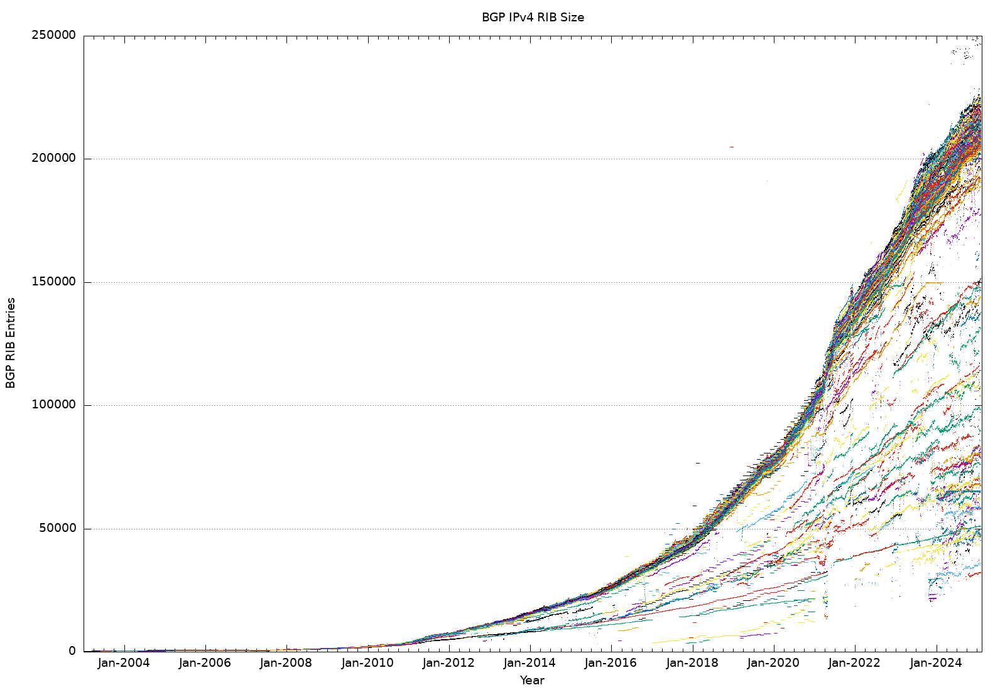
Meanwhile - IPv6

Slide 10
Meanwhile - IPv6
Growth model abruptly changes
(at the same time as IPv4)

Slide 11
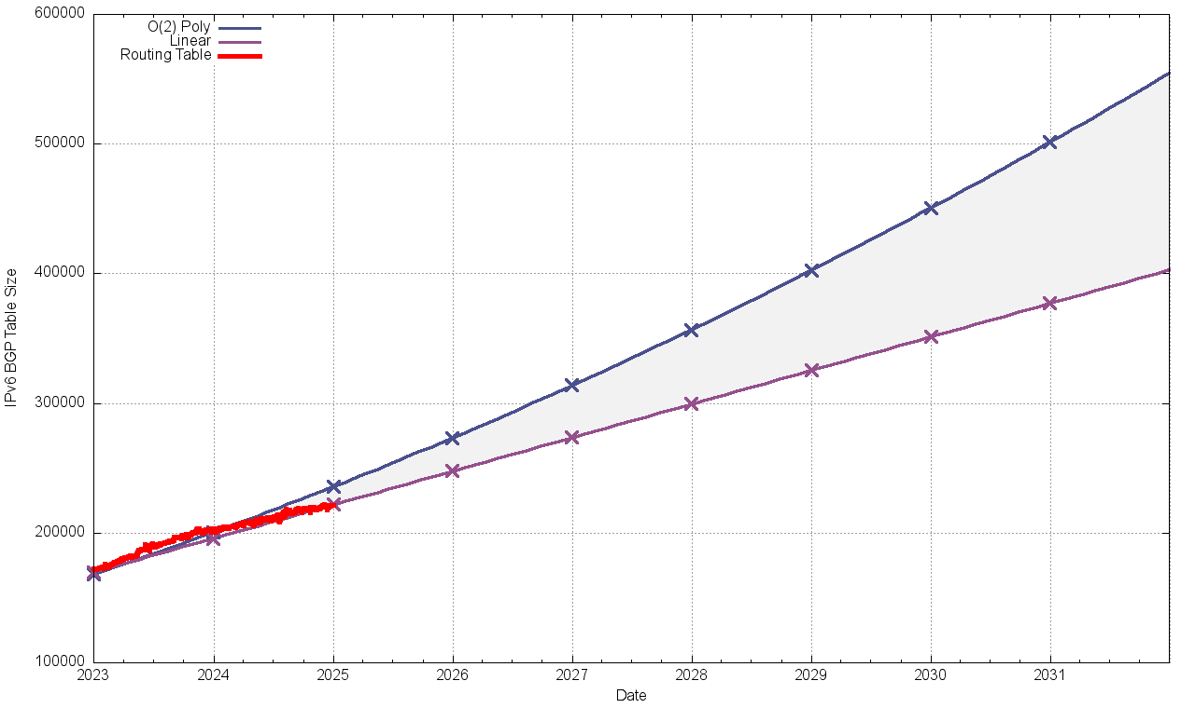
Where is this heading?
IPv6
550K Routes
400K Routes
2032

Slide 12
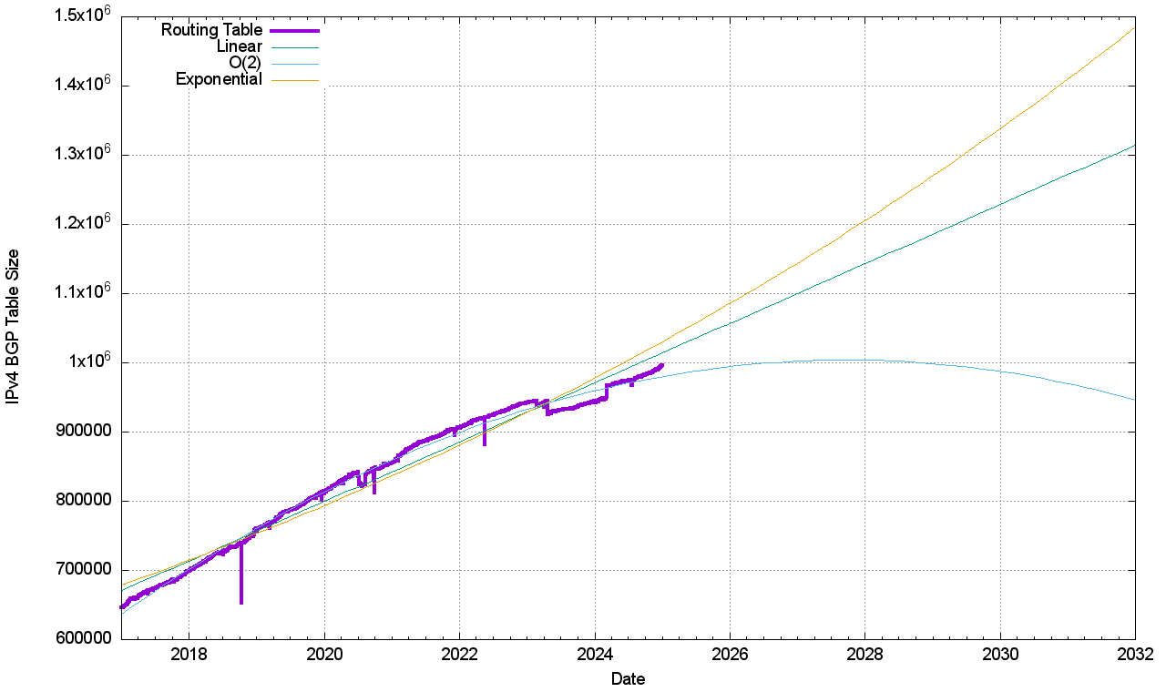
Where is this heading?
IPv4
1.5M Routes
950K Routes
2032

